Slide 1
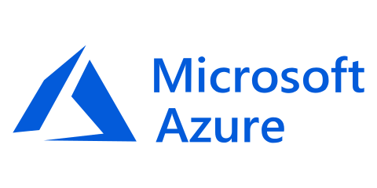
Provision, secure, connect, and run any infrastructure for any application
Notes:
Hi, my name is ________. I am the __________ for HashiCorp and here to talk about Terraform, one of the product in the HashiCorp Suite.
The mission of the HashiCorp suite is to provide products singularly focused on a goal: a product to provision, one to secure, one to run, and one to connect any infrastructure for any application.
Today we will talk about the provisioning piece with Terraform.

Slide 2

Introductions
Tom Straub
Cardinal Solutions Practice Manager
Developer/Cloud Architect
Curling!
https://www.cardinalsolutions.com
Notes:
Who am I?
Who is Cardinal?
Cardinal Solutions is a national solution provider. We lead with our experience and expertise in digital solutions across cloud, data and analytics, mobile, and web, while collaborating with clients through an agile process that allows organizations to be more creative and flexible in responding to user and stakeholder feedback. Established over 20 years ago, we continually evolve our solution offerings to adapt to the changes in technology and the needs of our customers. With 500 employees in seven locations in the Midwest and Southeast, we connect with clients across the country to help advance their business, while also providing strategic guidance, training, and mentoring.
Cardinal has a rich history of digital transformation with Azure. Our expertise in native cloud applications, mobile/digital, internet of things, analytics, and modern data center (including open source solutions) enables us to develop complex software solutions in the cloud. Our approach is to educate the customer on the possible, via real-life case studies, with the focus on innovation. Our portfolio includes over 50 successful deployments that range across a variety of industries and workloads. We help you craft a strategy that gets you started on the path to innovation in the cloud.

Slide 3
What’s in a Workshop
Clone the workshop repo
Slides -> Challenges -> Slides -> Challenges
Import links are at the bottom of the slides
https://github.com/CardinalNow/TerraformWorkshop
Notes:
This presentation is in the /docs folder
Mix of presentation and hands on labs
Links for more information

Slide 4
Workshop Expectations
Purpose
Why are we here?
Gives
What do you need to do?
Gets
What will get you get?
Notes:
Talk through goals of the workshop
Learn how and why Terraform on Azure
We need participation in the challenges, ask questions, etc…
They will get first hand experience with technical experts and a firm understanding of how to get started

Slide 5
Agenda
Introductions and Overview
Terraform Workflow
Lab: Connecting to Azure
Terraform Configuration
Lab: Provision Azure Virtual Machines
Terraform Internals & Modules
Lab: Provision Modules
Working Lunch
Overview of Terraform Enterprise
Terraform Enterprise - Workspaces
Terraform Enterprise - Private Module Registry
Terraform Enterprise - Sentinel
Notes:
Intro and Overview of IaC, Terraform, and Azure – give us a solid base to start discussing higher level topics

Slide 6
Hashicorp

Slide 7
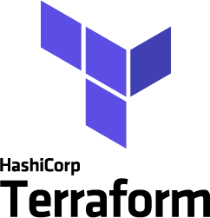


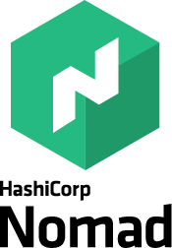

Company overview
Founded
2012 by Mitchell Hashimoto and Armon Dadgar
Mission
We enable organizations to Provision, Secure, Connect, and Run any infrastructure for any application
Key Products
Notes:
Just a quick background since some are probably more familiar than others with our company, we were founded a little over 4 years ago. What Mitchell and Armon observed as Ops practitioners was that as the world was shifting to cloud infrastructure, there was a real gap in the tools available to Ops professionals to help them provision, secure and run this infrastructure. Each of the cloud providers had their own tooling, but that had 2 obvious challenges:
using them would lock your applications into that particular environment (cue Oracle all over again) and
it left the natural gap of heterogeneity: how to manage the reality that this just introduced one more technology platform to manage — rather than a replacement it was an ‘and’.
To them, the tasks required of the ops practitioner to provision, secure and run this infrastructure were pretty clear — in principle the same as those performed for traditional infrastructure, but with tools more attuned to the challenges of cloud and distributed topologies. That was the genesis for Hashicorp: building a product suite for the practitioner to help them provision, secure and run hybrid cloud application infrastructure without tying themselves to a particular platform or technology.
The company is really much better known by its products — and in fact most people are unaware that these are all provided by a single company (it is a branding challenge that we are hard at work on addressing). The most popular of those is Vagrant which was the first product built and has more than 30,000 unique downloads each week. But Terraform, Vault, Consul and Nomad have grown incredibly in usage as well, to the point that between them they now generate more than 35,000 unique downloads per week themselves — a stat which has doubled in the past 6 months.
I’d be shocked if one or more of these tools isn’t in use at your company already.

Slide 8
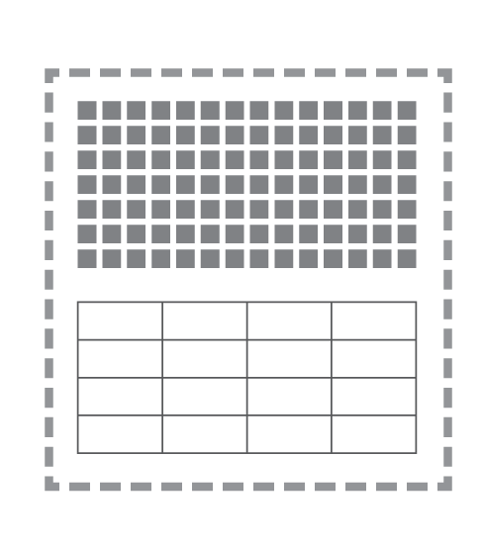
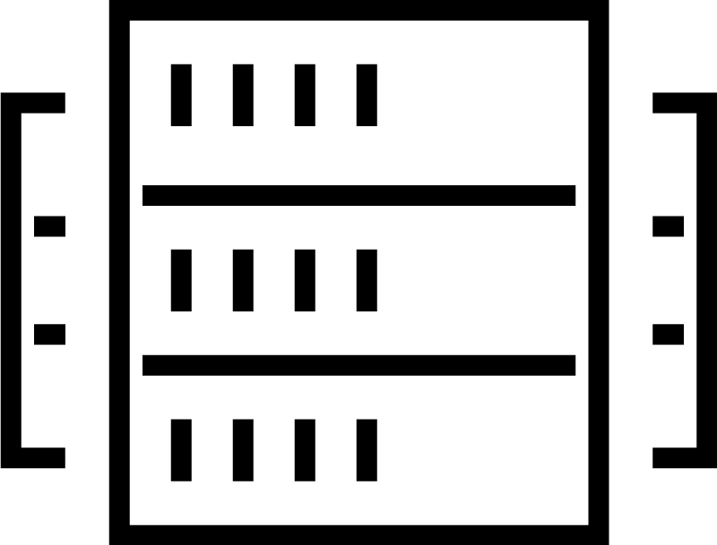
The shift to hybrid infrastructure
TRADITIONAL DATACENTER
Notes:
Go from core infrastructure.
Application platform
Security
As people make this transition those same three layers
The traditional approach to application infrastructure was relatively straightforward: the infrastructure layer was composed of physical servers running somewhere in a datacenter and then the runtime layer typically included virtual machines as the primary construct. Your application was then deconstructed across a relatively small number of VMs: perhaps a 3 tier app with a web server, app server and database in separate VMs.
As usage of that app increased, the approach was to scale up by adding more compute power at the infrastructure layer and more memory / processing power at the runtime layer.

Slide 9
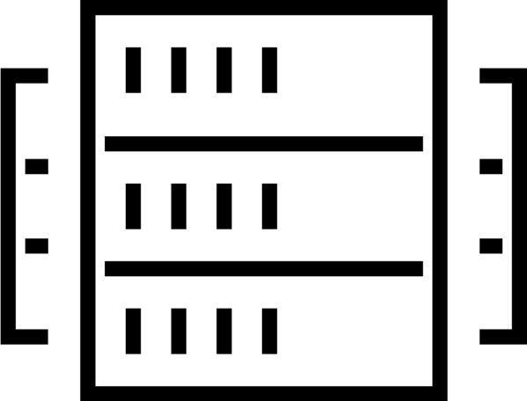

The shift to hybrid infrastructure
TRADITIONAL DATACENTER
EARLY CLOUD
Private cloud
AWS
Notes:
Go from core infrastructure.
Application platform
Security
As people make this transition those same three layers
The traditional approach to application infrastructure was relatively straightforward: the infrastructure layer was composed of physical servers running somewhere in a datacenter and then the runtime layer typically included virtual machines as the primary construct. Your application was then deconstructed across a relatively small number of VMs: perhaps a 3 tier app with a web server, app server and database in separate VMs.
As usage of that app increased, the approach was to scale up by adding more compute power at the infrastructure layer and more memory / processing power at the runtime layer.

Slide 10
The shift to hybrid infrastructure
TRADITIONAL DATACENTER
EARLY CLOUD
MULTI-CLOUD
+
Private cloud
AWS
Azure
GCP
…
Notes:
Go from core infrastructure.
Application platform
Security
As people make this transition those same three layers
The traditional approach to application infrastructure was relatively straightforward: the infrastructure layer was composed of physical servers running somewhere in a datacenter and then the runtime layer typically included virtual machines as the primary construct. Your application was then deconstructed across a relatively small number of VMs: perhaps a 3 tier app with a web server, app server and database in separate VMs.
As usage of that app increased, the approach was to scale up by adding more compute power at the infrastructure layer and more memory / processing power at the runtime layer.

Slide 11
The 3 essential elements of infrastructure
DEVELOPMENT
Run applications
SECURITY
Secure infrastructure & applications
OPERATIONS
Provision infrastructure
Notes:
people tend to think of the problem in this way.
address one at a time.

Slide 12
The 4 essential elements of distributed infrastructure
CONNECT
Infrastructure & applications
DEVELOPMENT
Run applications
SECURITY
Secure infrastructure & applications
OPERATIONS
Provision infrastructure
Notes:
people tend to think of the problem in this way.
address one at a time.

Slide 13
Addressing the challenges of cloud adoption

Slide 14
Cloud challenges for Operations teams
THE PRACTITIONER
DEVELOPMENT
Run applications
SECURITY
Secure infrastructure & applications
OPERATIONS
Scale
Heterogeneity
Dependency management
Provision infrastructure
Notes:
Ultimately that application must be deployed to the secure infrastructure. This is almost certainly a multi-component app spanning a data layer and a runtime layer, meaning that it almost certainly has heterogenous elements spanning VMs to Containers and probably physical components as well (e.g. a database NOT inside a VM for performance reasons).
And finally the application must be registered with a common service registry so that it can be monitored by the ops team.
That is really the end-to-end software supply chain: the principles have not changed for a long time, but just as the evolution from producing combustion engines to electric engines caused factories to be retooled to accommodate the addition of some new components, the software supply chain requires new tooling to support the realities of modern application infrastructure. It is hybrid, distributed and dynamic in a way that the existing toolchains really aren't designed.

Slide 15
Provision any infrastructure for any application
THE PRACTITIONER
DEVELOPMENT
Run applications
SECURITY
Secure infrastructure & applications
OPERATIONS
Scale
Heterogeneity
Dependency management
Provision infrastructure

Slide 16
Provision any infrastructure for any application
Extensible provider model
AWS
GCP
OPERATIONS
Core
Azure
Provision infrastructure
Alibaba
API Integration

Slide 17
Provision any infrastructure for any application
Extensible provider model
AWS
GCP
OPERATIONS
Core
Azure
Provision infrastructure
Alibaba
API Integration
Notes:
Terraform Core split from Terraform Providers
Providers can be added and expanded at anytime
Provider categories include:
Cloud providers: AWS, Azure, GCP, Alibaba, Oracle, IBM, and more
Other ISVs providers: DNSimple, Datadog, Consul, GitHub, Fastly, and more

Slide 18
Provision any infrastructure for any application
Extensible provider model
Fastly
GitHub
…
Kubernetes
Heroku
…
DNSimple
Akamai
…
Datadog
F5
…
AWS
GCP
OPERATIONS
Core
Azure
Provision infrastructure
Alibaba
API Integration
Notes:
Terraform Core split from Terraform Providers
Providers can be added and expanded at anytime
Provider categories include:
Cloud providers: AWS, Azure, GCP, Alibaba, Oracle, IBM, and more
Other ISVs providers: DNSimple, Datadog, Consul, GitHub, Fastly, and more

Slide 19
Provision any infrastructure for any application
OPERATOR
Core
Azure
Kubernetes
Datadog
Notes:
- Consistent workflow for every provider
- Codify resource in a Terraform configuration
- Producer & consumer model
Operators produce infrastructure configurations
Developers consume infrastructure configurations

Slide 20

Provision any infrastructure for any application
Infrastructure as Code
OPERATOR
Core
Azure
Kubernetes
Terraform Configuration
Datadog
Notes:
- Consistent workflow for every provider
- Codify resource in a Terraform configuration
- Producer & consumer model
Operators produce infrastructure configurations
Developers consume infrastructure configurations

Slide 21
Provision any infrastructure for any application
Infrastructure as Code
DEVELOPERS
OPERATOR
Core
Azure
Kubernetes
Terraform Configuration
Datadog
Notes:
- Consistent workflow for every provider
- Codify resource in a Terraform configuration
- Producer & consumer model
Operators produce infrastructure configurations
Developers consume infrastructure configurations

Slide 22
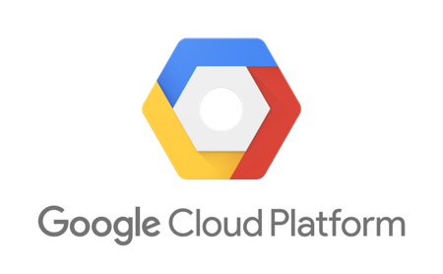

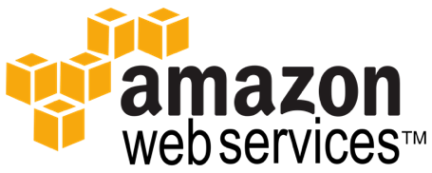



Terraform Ecosystem
Partnerships with 25+ technology providers, community support for many more
Version-control Systems
Infrastructure providers
Core
Provider
List of all 70+ providers www.terraform.io/docs/providers/
Notes:
As we have talked though the provisioning workflow with Terraform and then Terraform Enterprise, there are many spots to integrate with tooling and infrastructure of your choice.
One of our philosophies at HashiCorp is to be open and extensible in our products, open integrating and extensible to technology. Currently, we have over 25+ formal technical partnerships with many of infrastructure providers through community involvement.
Here are some of the more common integrations with VCS, including offerings from GitHub, GitLab, and BitBucket.
On the infrastructure side, the core cloud providers with a full list of 70+ providers available on our docs site at terraform.io.

Slide 23
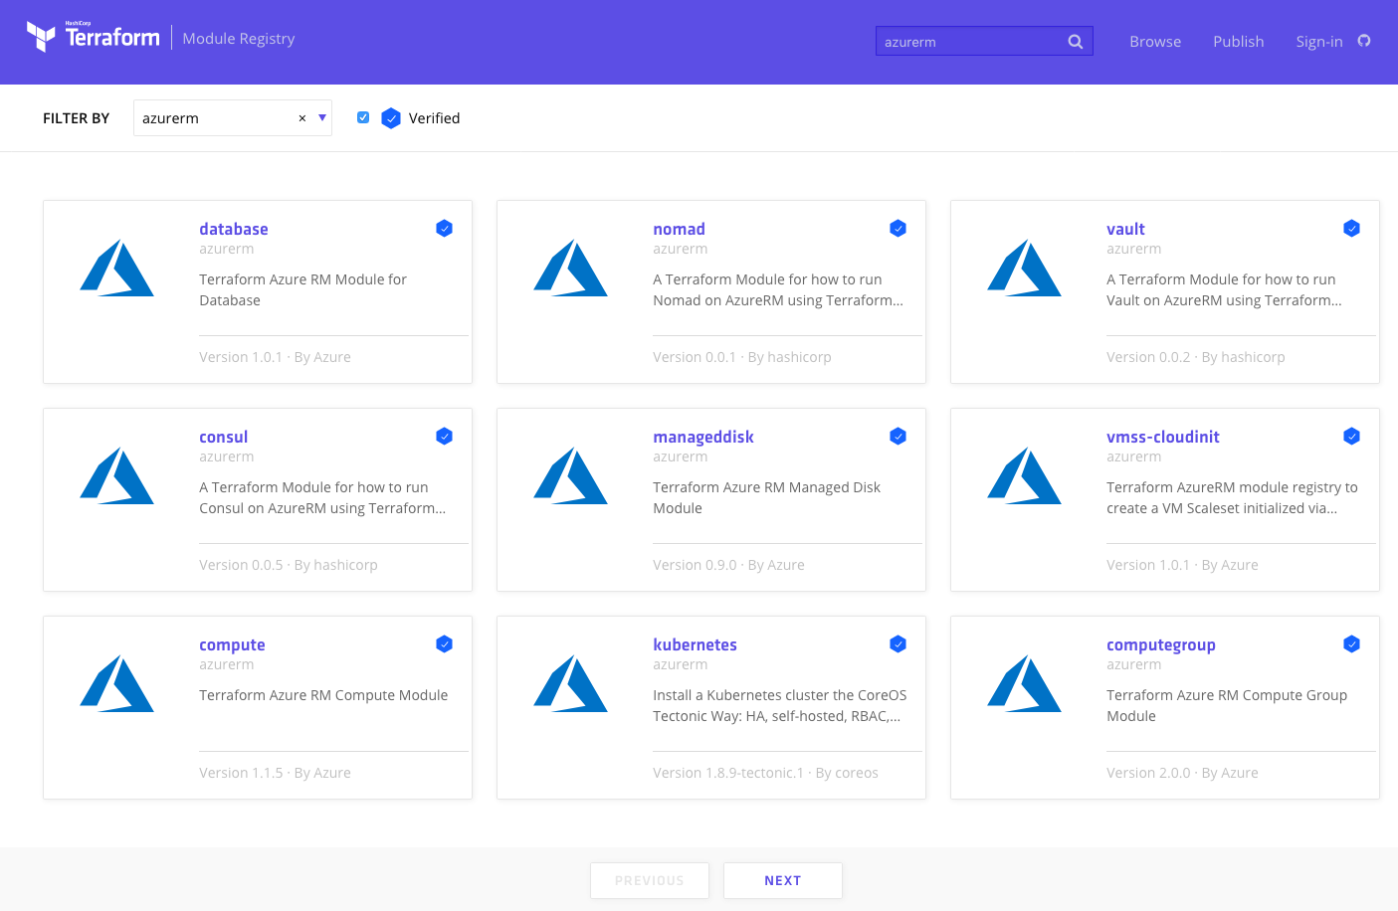
Public Module Registry
https://registry.terraform.io
Notes:
Publish modules
Reusable blocks of code
Terraform Enterprise – offers Private Module Registry

Slide 24
Azure Resource Manager

Slide 25
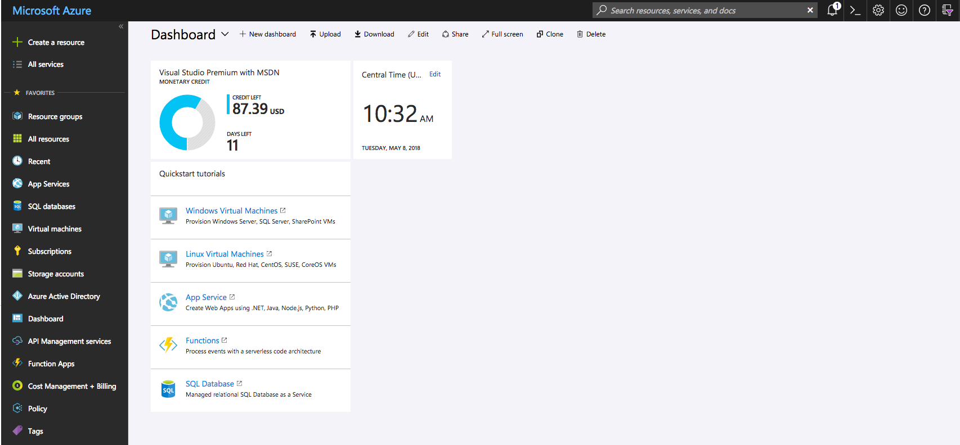
Azure Portal
https://portal.azure.com
https://portal.azure.com
Notes:
We will be using this throughout the day

Slide 26
High Level View
Notes:
Every Tenant can have multiple subscriptions (but a sub can only be in a single tenant)
Each Subscription can have multiple resource groups (but a RG can only be in a single sub)
Each resource can have multiple resources (but a resource can only be in a single RG)
Mention Location/Regions

Slide 27
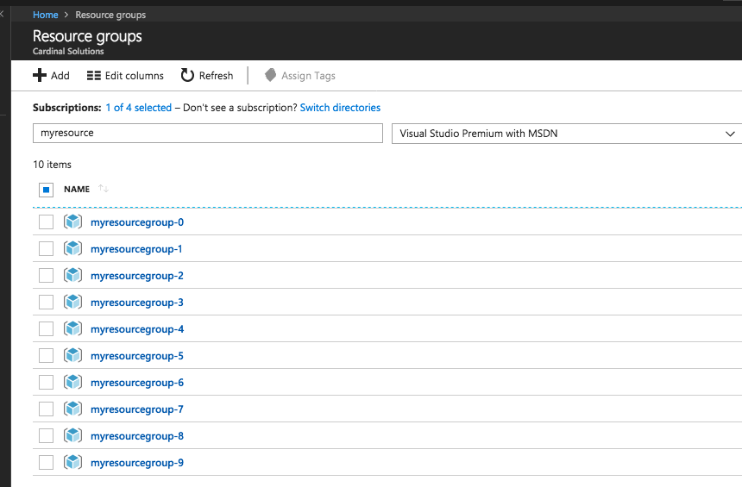
Azure Resource Manager
Resource Group
A container that holds
related resources.
https://portal.azure.com
Notes:
resource group
A container that holds related resources for an Azure solution. The resource group can include all the resources for the solution, or only those resources that you want to manage as a group.
You can deploy, update, or delete all the resources for your solution in a single, coordinated operation.
resource provider
A service that supplies the resources you can deploy and manage through Resource Manager.
Each resource provider offers operations for working with the resources that are deployed.
Some common resource providers are Microsoft.Compute, which supplies the virtual machine resource, Microsoft.Storage, which supplies the storage account resource, and Microsoft.Web, which supplies resources related to web apps. See Resource providers.

Slide 28
Azure Resource Manager
Resource
A manageable item that is available through Azure.
Some common resources are a virtual machine, storage account, web app, database, and virtual network, but there are many more!
Notes:
resource group
A container that holds related resources for an Azure solution. The resource group can include all the resources for the solution, or only those resources that you want to manage as a group.
You can deploy, update, or delete all the resources for your solution in a single, coordinated operation.
resource provider
A service that supplies the resources you can deploy and manage through Resource Manager.
Each resource provider offers operations for working with the resources that are deployed.
Some common resource providers are Microsoft.Compute, which supplies the virtual machine resource, Microsoft.Storage, which supplies the storage account resource, and Microsoft.Web, which supplies resources related to web apps. See Resource providers.

Slide 29
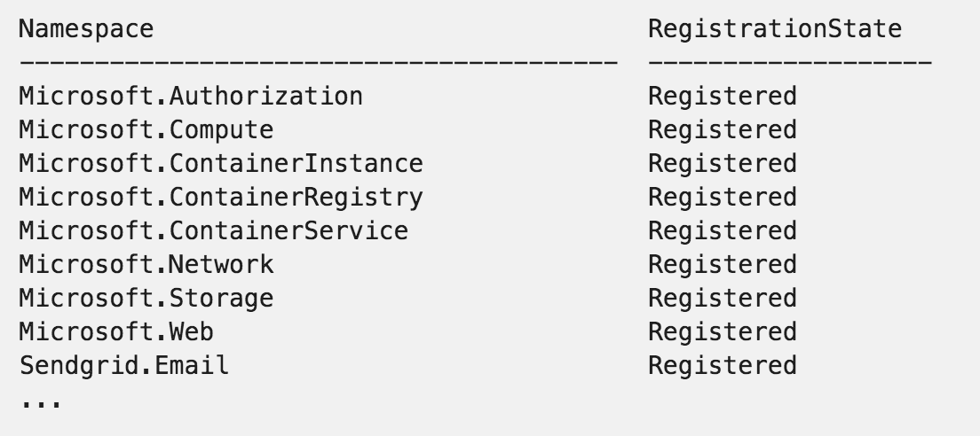
Azure Resource Manager
Resource Provider
A service that supplies the resources you can deploy and manage through Resource Manager.
Notes:
resource group
A container that holds related resources for an Azure solution. The resource group can include all the resources for the solution, or only those resources that you want to manage as a group.
You can deploy, update, or delete all the resources for your solution in a single, coordinated operation.
resource provider
A service that supplies the resources you can deploy and manage through Resource Manager.
Each resource provider offers operations for working with the resources that are deployed.
Some common resource providers are Microsoft.Compute, which supplies the virtual machine resource, Microsoft.Storage, which supplies the storage account resource, and Microsoft.Web, which supplies resources related to web apps. See Resource providers.

Slide 30
Azure Resource Manager
Resource Group
Virtual Network
Subnet
Network Interface
Virtual Machine
OS Disk (from Image)
Resource Group
Virtual Network
Subnet
Network Security Group
Network Interface
Virtual Machine
OS Disk (from Image)
Data Disk(s)
Extensions
Notes:
Add icons to this slide to drive the point
RG with a Vnet/Subnet, few NICs, few VMS Could show a Load Balance, NSG, etc…

Slide 31
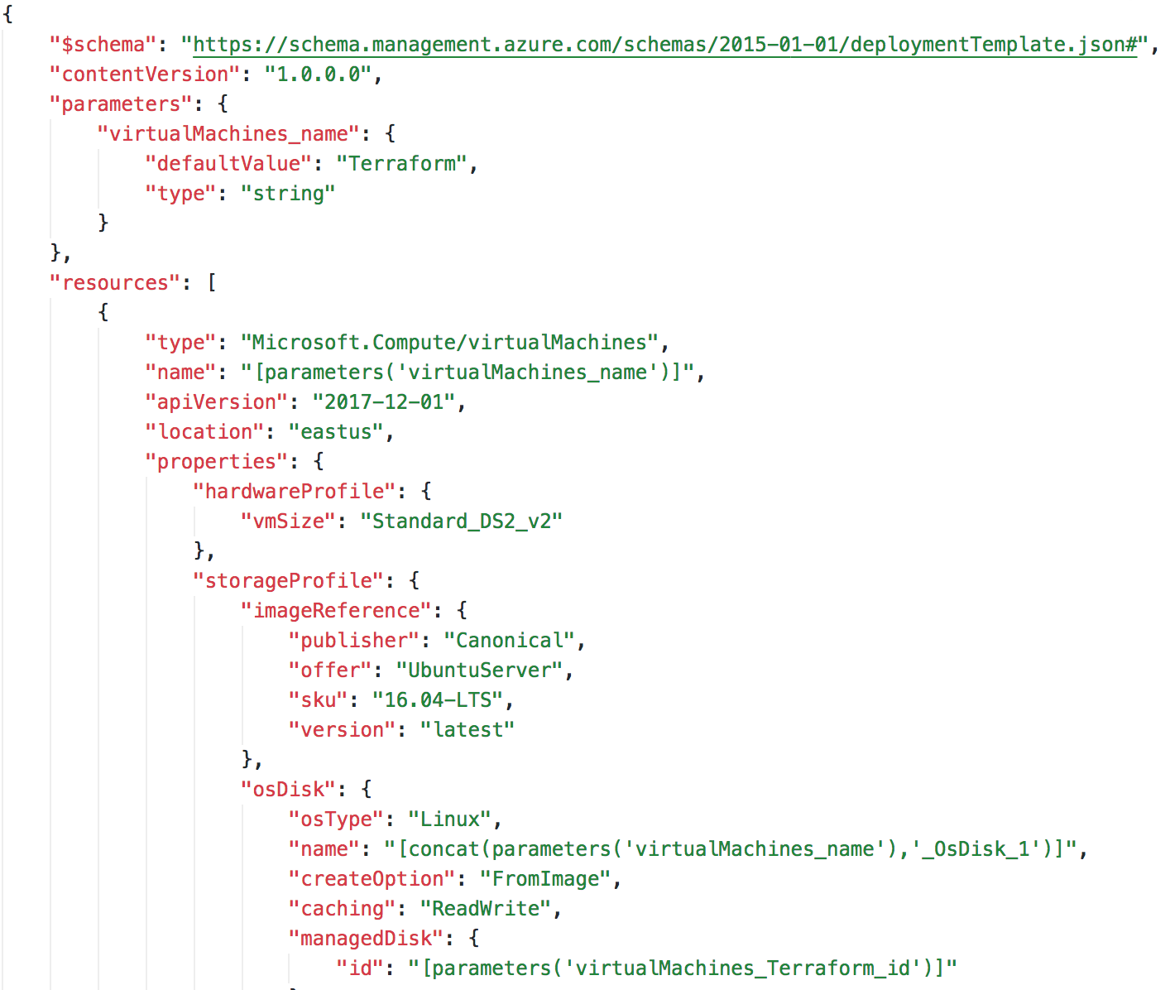
Azure Resource Manager Templates
ARM Templates
JSON file that defines one or
more resources to deploy to a
resource group.
Notes:
When you create anything in the Portal, it is creating an ARM Template and submitting that to a deployment.
Azure Deployment Model

Slide 32
ARM Templates Drawbacks
Cannot verify changes to an environment before executing
Failures can be difficult to trace
Deployments cannot cross resource groups (or subscriptions)
Custom tooling to create a full deployment
Notes:
There are other and overlapping tools out there.
Most tools combine plan and execution
One tool that can deploy to multiple platforms
Can represent infra and CDN or DNS services, etc…

Slide 33
Why Terraform?
Enables organizations to adopt an Infrastructure as Code
Import existing Infrastructure
Support for Linux and Windows Virtual Machines
Separate planning and execution phases
Represents entire infrastructure and supporting services with a common language
Notes:
There are other and overlapping tools out there.
Most tools combine plan and execution
One tool that can deploy to multiple platforms
Can represent infra and CDN or DNS services, etc…
MICROSOFT!

Slide 34
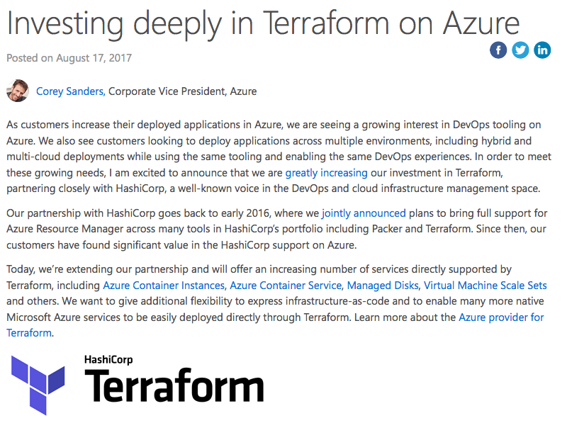
Microsoft <3 Terraform
Microsoft Investing in Terraform
Azure Container Instance
Azure Kubernetes Service
https://aka.ms/terraform
https://aka.ms/terraformdocs
https://azure.microsoft.com/en-us/blog/investing-deeply-in-terraform-on-azure/
Notes:
2017, Hashicorp and Microsoft official partners.
Terraform is a first class citizen in Azure
Azurerm new resources quickly
ACI – GA
AKS – Preview
Event Grid - ~1 week

Slide 35
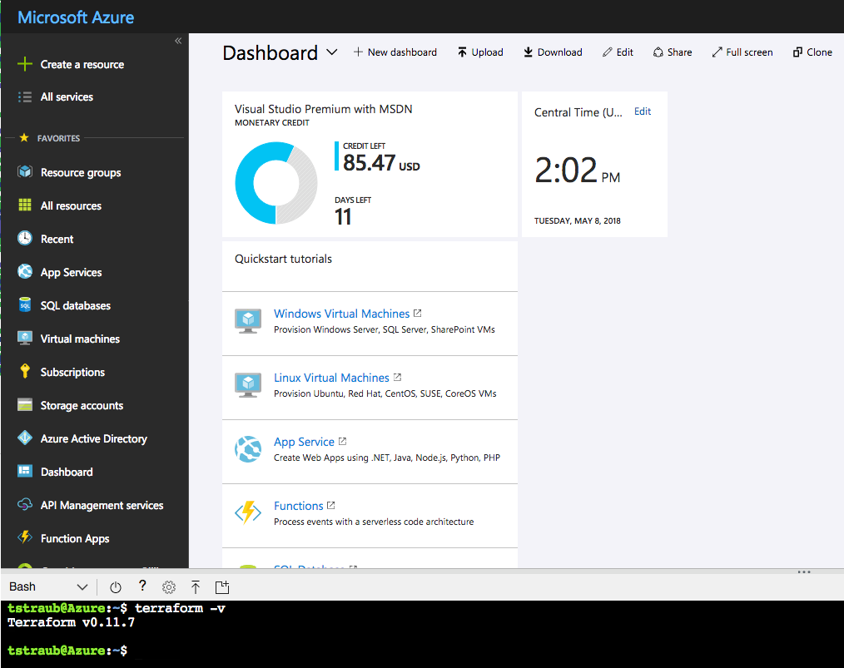
Microsoft <3 Terraform
Azure Cloud Shell Integration
https://docs.microsoft.com/en-us/azure/terraform/terraform-cloud-shell
Notes:
Latest version of Terraform.
Can run Terraform from the Azure Cloud Shell – WILL DEMO THIS LATER

Slide 36
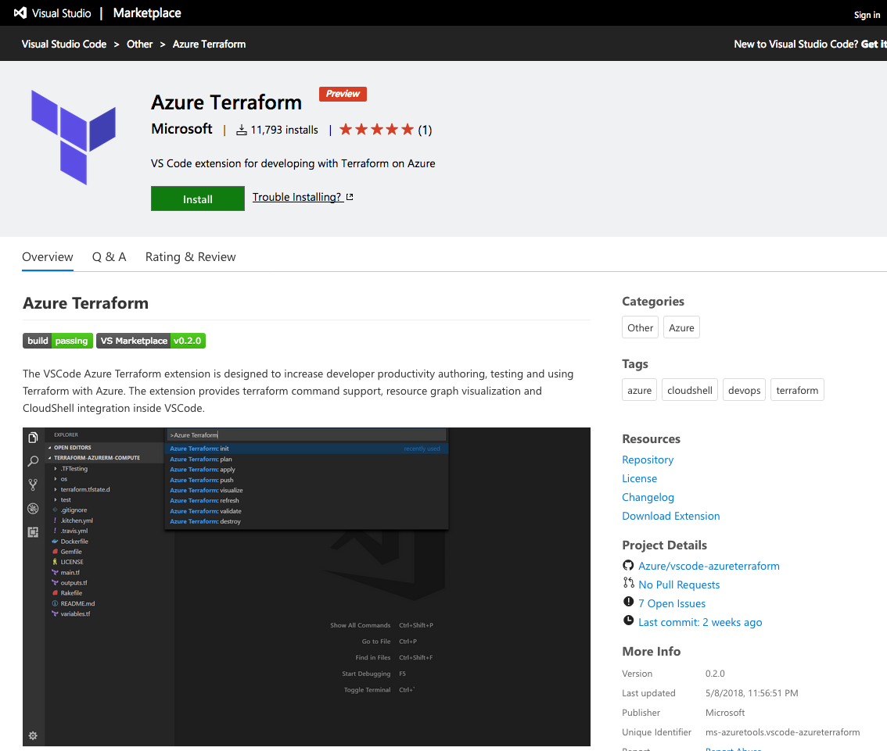
Microsoft <3 Terraform
VS Code Extension
https://docs.microsoft.com/en-us/azure/terraform/terraform-cloud-shell
Notes:
Integrates with the Azure Cloud Shell
Allows pushing local code to the Cloud Shell
Preview

Slide 37
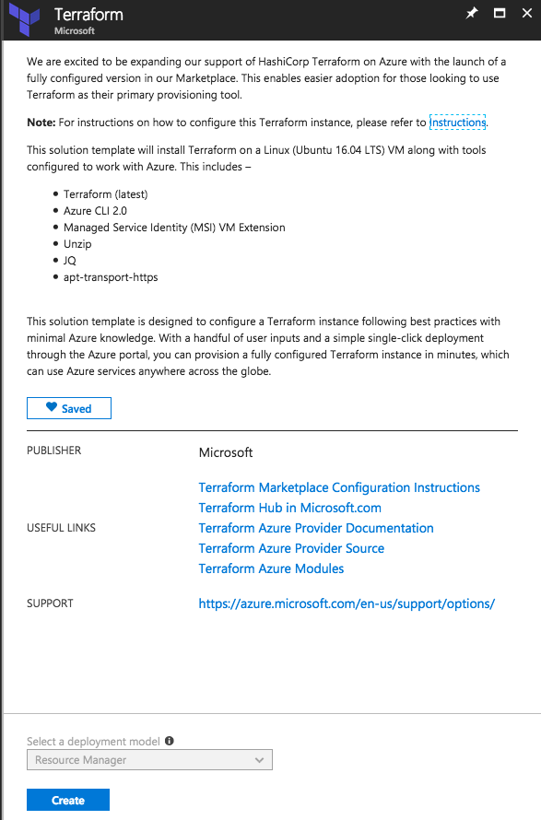
Microsoft <3 Terraform
Terraform Marketplace Image
Creates a VM with system-assigned identity that's based on the Ubuntu 16.04 LTS image.
Installs the MSI extension on the VM to allow OAuth tokens to be issued for Azure resources.
Assigns RBAC permissions to the managed identity, granting owner rights for the resource group.
Creates a Terraform template folder (tfTemplate).
Pre-configures a Terraform remote state with the Azure back end.
https://aka.ms/aztfmkt
Notes:
Remote State Backend
Managed Service Identity – handles OATH

Slide 38
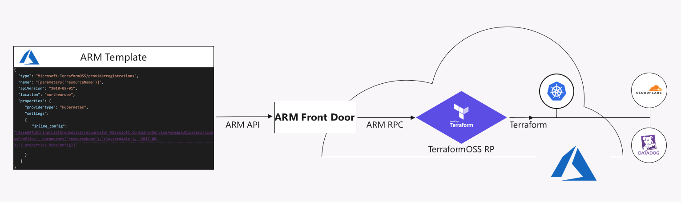
Microsoft <3 Terraform
Terraform 3rd Party Azure Provider
https://azure.microsoft.com/en-us/blog/introducing-the-azure-terraform-resource-provider/
Notes:
Terraform built-in provider

Slide 39
Break

Slide 40
Terraform

Slide 41


Terraform
https://www.terraform.io/
Open Source Software
https://github.com/hashicorp/terraform
Written in GO
https://golang.org/
Notes:
OSS, hosted on Github
GoLang – single executable

Slide 42
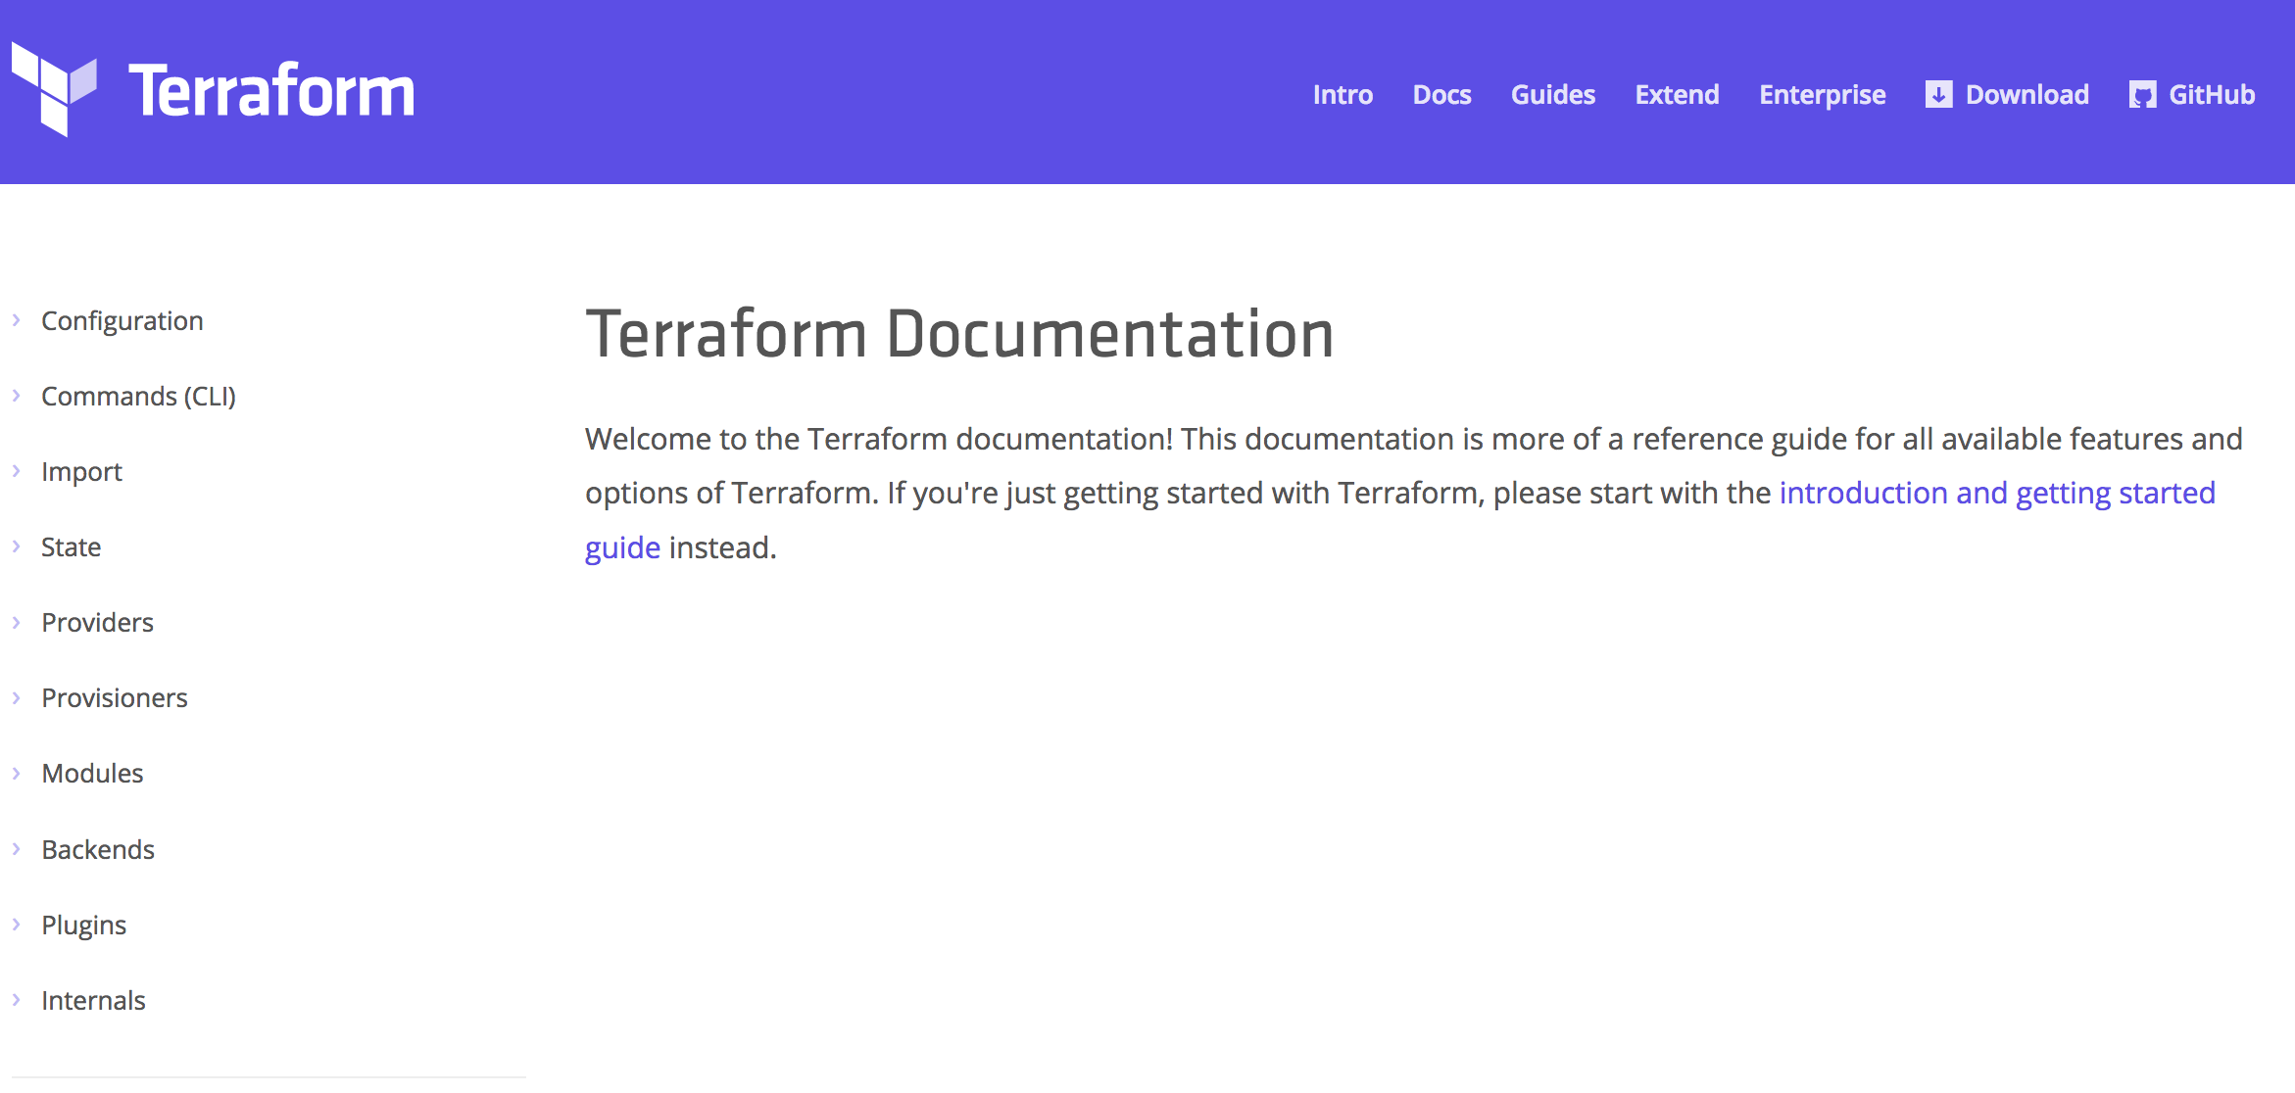
Terraform Documentation
https://www.terraform.io/docs
Notes:
Great documentation.
Constantly being updated.

Slide 43
Provision any infrastructure for any application
Core
Azure

Slide 44
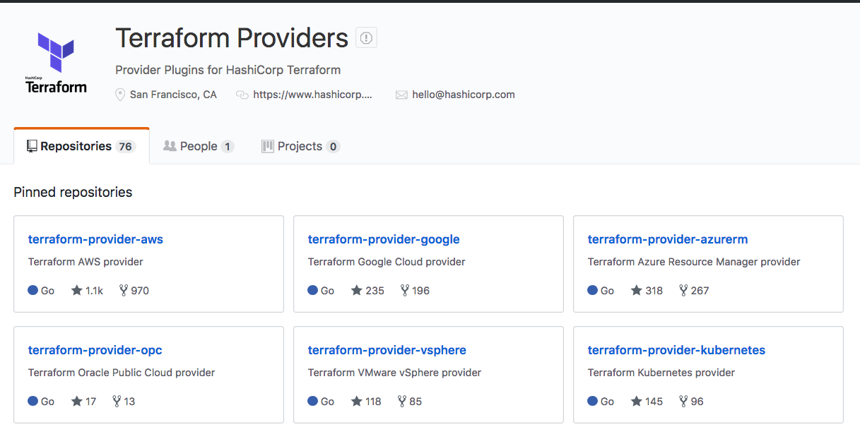
Terraform Providers
https://github.com/terraform-providers
Notes:
Terraform Providers are in their own Github Organization
Terraform only pulls in what is needed based on your configuration `terraform init`
Aka.ms/terraform

Slide 45
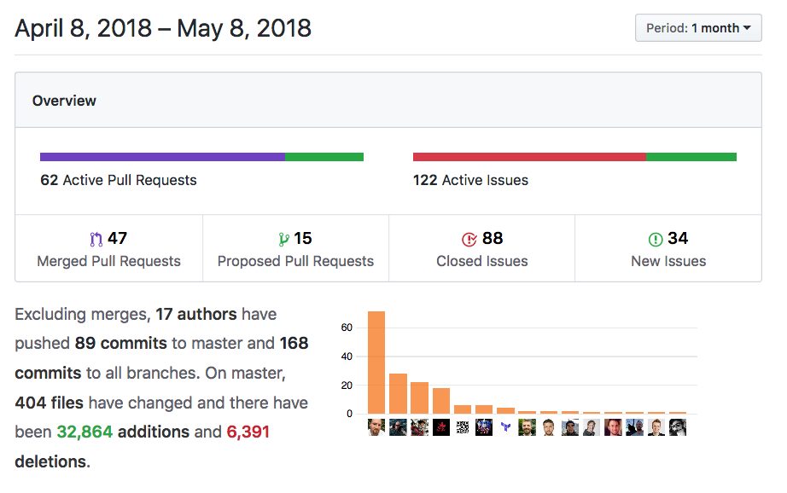
Azure Provider
100+ resources
Very active code base
Frequent releases
Jan 2018 -> v1.0.0
May 2018 -> v1.4.0
Great visibility into progress
https://github.com/terraform-providers/terraform-provider-azurerm
Notes:
100+ resources, more added every week.
Active code base – 47 Merged PR in 1 month
Frequent releases - 10 official releases in 5 months
Actively see what is being progress (Submit an Issue if you have a problem)

Slide 46
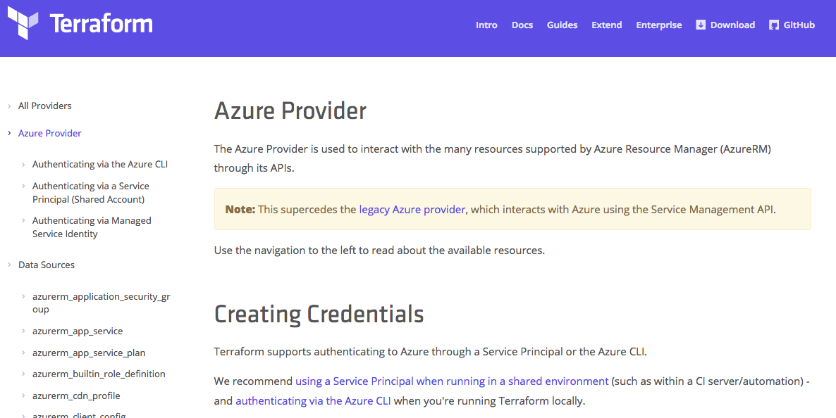
Azure Provider Documentation
https://www.terraform.io/docs/providers/azurerm

Slide 47
Hashicorp Configuration Language
Human-readable configuration (HCL) is designed for human consumption so users can quickly interpret and understand their infrastructure configuration.
HCL includes a full JSON parser for machine-generated configurations.
https://github.com/hashicorp/hcl

Slide 48
main.tf
resource "azurerm_resource_group" "myfirstrg" {
name = "myfirstresourcegroup"
location = ”eastus"
}
Notes:
‘resource’ is a TF Core type
‘azurerm_resource_group’ is an AzureRM provider resource.
‘myfirstrg’ is a scoping name to the resource (for planning, etc…)
‘name’ and ‘location’ are parameters set for a resource.
https://www.terraform.io/docs/configuration/syntax.html

Slide 49
Terraform in Action

Slide 50
Terraform Workflow
Init
Plan
Core
Provider
Apply
Notes:
Walk through the workflow
Only *.tf files that are in the current directory (nothing nested).
Init – happens once, pull dependencies
Plan

Slide 51
DEMO
Notes:
DEMO the basic init/plan/apply from the Azure Cloud Shell
Next few slides are back up/reference.

Slide 52
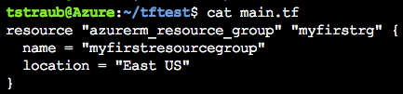
Notes:
Consider a simple resource group

Slide 53
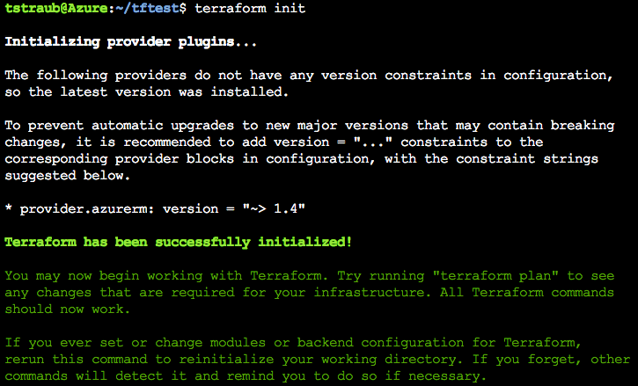
Notes:
Init
Reads configuration
initialize providers
Loads state file

Slide 54
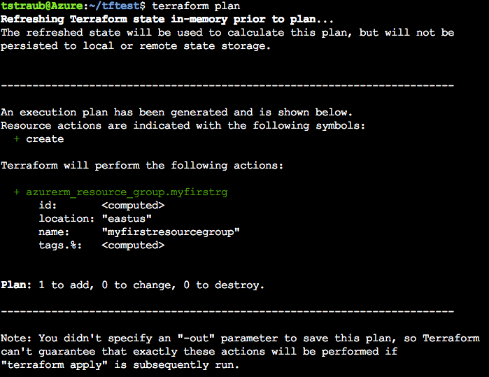
Notes:
Plan
Determines what infrastructure is needed and displays it

Slide 55
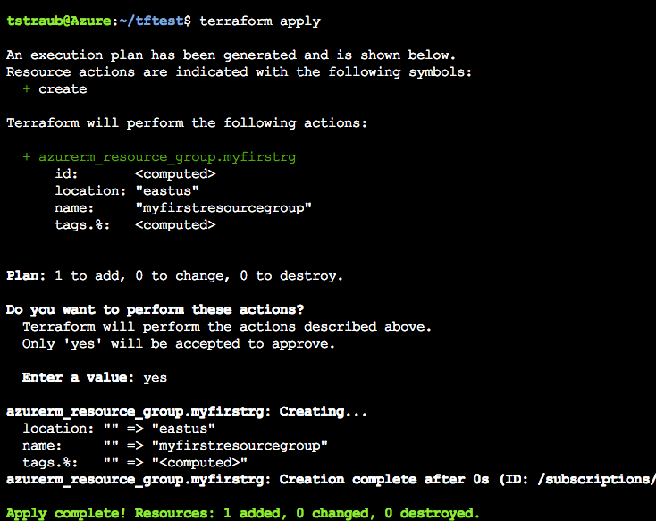
Notes:
Apply
Reruns a plan and prompts for confirmation before continuing
‘yes’ -> Applies the configuration

Slide 56
Terraform Configuration

Slide 57
Terraform
terraform {
required_version = "= 0.11.7"
}
= | Exact version equality | = 0.11.7
!= | Exclude version | != 0.11.6
> >= < <= | Version comparison | >= 0.11.4
~> | Pessimistic constraint | ~> 0.11.7
https://www.terraform.io/docs/configuration/terraform.html
Notes:
Not required.
Version pinning, good idea in production.
= is optional, defaults
Pessimistic will go up until the next major version

Slide 58
AzureRm Provider
provider "azurerm" {
version = "1.4.0"
}
https://www.terraform.io/docs/providers/azurerm/index.html
Notes:
Specify the version
Same as terraform but for the provider.
Same compare rules.

Slide 59
Authentication to Azure
Azure CLI
az login
Uses your own credentials
Great for local development
Also how the Azure Cloud Shell works
Notes:
Great for testing
Can use this today, but since we will need the SP later, go ahead and create it

Slide 60
Authentication to Azure
Service Principal
Preferred for shared environments
Works well in automation
Also how Terraform Enterprise works
Notes:
You will generate these on your subscription in the challenges

Slide 61
Authentication to Azure
Service Principal
provider "azurerm" {
version = "1.4.0"
subscription_id = "SUBSCRIPTION-ID"
client_id = "CLIENT-ID"
client_secret = "CLIENT-SECRET"
tenant_id = "TENANT-ID"
}
Notes:
Can set them in the configuration

Slide 62
Authentication to Azure
Service Principal
export ARM_TENANT_ID=
export ARM_SUBSCRIPTION_ID=
export ARM_CLIENT_ID=
export ARM_CLIENT_SECRET=
Notes:
Preferred method
Easiest to blend into automation
How Terraform Enterprise will get these values.

Slide 63
Azure Location
resource "azurerm_resource_group" "main" {
location = "eastus"
}
resource "azurerm_resource_group" "main" {
location = “East US”
}
Notes:
Location equivalent
Pick either format, just be consistent
We use `eastus` in this workshop

Slide 64
Challenge
00 - Getting Started
01 - Connecting to Azure
Notes:
30-45 mins Walk through the challenges
Setup Environment
Connect to the Azure CLI
Create a Resource Group
Goal: get setup/connected/building infrastructure
Combine this as a break

Slide 65
Terraform State

Slide 66
Terraform State
File that stores state about your managed infrastructure
Keeps track of resource metadata
Used to map real world resources to your configuration.
Local terraform.tfstate file by default
https://www.terraform.io/docs/state

Slide 67
Terraform State
Config: Desired State
State: Current State
Diff: Delta of {Desired & Current}
Plan: Presents Diff
Apply: Resolves Diff
https://www.terraform.io/docs/state/remote.html

Slide 68
Terraform State
https://www.terraform.io/docs/state/remote.html
Notes:
Connecting these 3 points.

Slide 69

Terraform State
State file can contain sensitive data
https://www.terraform.io/docs/state/sensitive-data.html
Notes:
Do not store in source control
Such as usernames, passwords, keys…
Encrypted at rest in Azure storage accounts

Slide 70
Terraform State - Remote
Remote state
Backend
Local is default
Teams/collab
In memory state only
https://www.terraform.io/docs/state/remote.html

Slide 71
Terraform State – Operations
Configuration | State | Reality | Operation
azurerm_virtual_machine.app
https://www.terraform.io/docs/state/remote.html

Slide 72
Terraform State – Operations
Configuration | State | Reality | Operation
azurerm_virtual_machine.app |  |  | CREATE
https://www.terraform.io/docs/state/remote.html

Slide 73
Terraform State – Operations
Configuration | State | Reality | Operation
azurerm_virtual_machine.app |  |  | CREATE
azurerm_virtual_machine.app | azurerm_virtual_machine.app
https://www.terraform.io/docs/state/remote.html

Slide 74
Terraform State – Operations
Configuration | State | Reality | Operation
azurerm_virtual_machine.app |  |  | CREATE
azurerm_virtual_machine.app | azurerm_virtual_machine.app |  | CREATE
https://www.terraform.io/docs/state/remote.html

Slide 75
Terraform State – Operations
Configuration | State | Reality | Operation
azurerm_virtual_machine.app |  |  | CREATE
azurerm_virtual_machine.app | azurerm_virtual_machine.app |  | CREATE
azurerm_virtual_machine.app | azurerm_virtual_machine.app | azurerm_virtual_machine.app
https://www.terraform.io/docs/state/remote.html

Slide 76
Terraform State – Operations
Configuration | State | Reality | Operation
azurerm_virtual_machine.app |  |  | CREATE
azurerm_virtual_machine.app | azurerm_virtual_machine.app |  | CREATE
azurerm_virtual_machine.app | azurerm_virtual_machine.app | azurerm_virtual_machine.app | NOOP
https://www.terraform.io/docs/state/remote.html

Slide 77
Terraform State – Operations
Configuration | State | Reality | Operation
azurerm_virtual_machine.app |  |  | CREATE
azurerm_virtual_machine.app | azurerm_virtual_machine.app |  | CREATE
azurerm_virtual_machine.app | azurerm_virtual_machine.app | azurerm_virtual_machine.app | NOOP
 | azurerm_virtual_machine.app | azurerm_virtual_machine.app
https://www.terraform.io/docs/state/remote.html

Slide 78
Terraform State – Operations
Configuration | State | Reality | Operation
azurerm_virtual_machine.app |  |  | CREATE
azurerm_virtual_machine.app | azurerm_virtual_machine.app |  | CREATE
azurerm_virtual_machine.app | azurerm_virtual_machine.app | azurerm_virtual_machine.app | NOOP
 | azurerm_virtual_machine.app | azurerm_virtual_machine.app | DELETE
https://www.terraform.io/docs/state/remote.html

Slide 79
Terraform State – Operations
Configuration | State | Reality | Operation
azurerm_virtual_machine.app |  |  | CREATE
azurerm_virtual_machine.app | azurerm_virtual_machine.app |  | CREATE
azurerm_virtual_machine.app | azurerm_virtual_machine.app | azurerm_virtual_machine.app | NOOP
 | azurerm_virtual_machine.app | azurerm_virtual_machine.app | DELETE
 |  | azurerm_virtual_machine.app
https://www.terraform.io/docs/state/remote.html

Slide 80
Terraform State – Operations
Configuration | State | Reality | Operation
azurerm_virtual_machine.app |  |  | CREATE
azurerm_virtual_machine.app | azurerm_virtual_machine.app |  | CREATE
azurerm_virtual_machine.app | azurerm_virtual_machine.app | azurerm_virtual_machine.app | NOOP
 | azurerm_virtual_machine.app | azurerm_virtual_machine.app | DELETE
 |  | azurerm_virtual_machine.app | NOOP
https://www.terraform.io/docs/state/remote.html

Slide 81
Terraform State – Operations
Configuration | State | Reality | Operation
azurerm_virtual_machine.app |  |  | CREATE
azurerm_virtual_machine.app | azurerm_virtual_machine.app |  | CREATE
azurerm_virtual_machine.app | azurerm_virtual_machine.app | azurerm_virtual_machine.app | NOOP
 | azurerm_virtual_machine.app | azurerm_virtual_machine.app | DELETE
 |  | azurerm_virtual_machine.app | NOOP
azurerm_virtual_machine.app |  | azurerm_virtual_machine.app
https://www.terraform.io/docs/state/remote.html

Slide 82
Terraform State – Operations
Configuration | State | Reality | Operation
azurerm_virtual_machine.app |  |  | CREATE
azurerm_virtual_machine.app | azurerm_virtual_machine.app |  | CREATE
azurerm_virtual_machine.app | azurerm_virtual_machine.app | azurerm_virtual_machine.app | NOOP
 | azurerm_virtual_machine.app | azurerm_virtual_machine.app | DELETE
 |  | azurerm_virtual_machine.app | NOOP
azurerm_virtual_machine.app |  | azurerm_virtual_machine.app | RECREATE
https://www.terraform.io/docs/state/remote.html

Slide 83
Terraform State – Operations
Configuration | State | Reality | Operation
azurerm_virtual_machine.app |  |  | CREATE
azurerm_virtual_machine.app | azurerm_virtual_machine.app |  | CREATE
azurerm_virtual_machine.app | azurerm_virtual_machine.app | azurerm_virtual_machine.app | NOOP
 | azurerm_virtual_machine.app | azurerm_virtual_machine.app | DELETE
 |  | azurerm_virtual_machine.app | NOOP
azurerm_virtual_machine.app |  | azurerm_virtual_machine.app | RECREATE
 | azurerm_virtual_machine.app
https://www.terraform.io/docs/state/remote.html

Slide 84
Terraform State – Operations
Configuration | State | Reality | Operation
azurerm_virtual_machine.app |  |  | CREATE
azurerm_virtual_machine.app | azurerm_virtual_machine.app |  | CREATE
azurerm_virtual_machine.app | azurerm_virtual_machine.app | azurerm_virtual_machine.app | NOOP
 | azurerm_virtual_machine.app | azurerm_virtual_machine.app | DELETE
 |  | azurerm_virtual_machine.app | NOOP
azurerm_virtual_machine.app |  | azurerm_virtual_machine.app | RECREATE
 | azurerm_virtual_machine.app |  | REMOVE FROM STATE
https://www.terraform.io/docs/state/remote.html

Slide 85
Variables

Slide 86
Variables
variable "location" {
default = ”eastus"
description = ”Location to deploy Azure Infrastructure"
}
resource "azurerm_resource_group" "module" {
name = ”my-rg"
location = "${var.location}"
}
https://www.terraform.io/docs/configuration/variables.html
Notes:
Can be default or else required.
Default are literal and can not be interpolated.
Type is assumed.
Interpolation, more to come, VERY powerful
Description is purely for documentation (TF Registry)

Slide 87
Variables - Types
variable "key" {
type = "string"
default = "value"
}
https://www.terraform.io/docs/configuration/variables.html

Slide 88
Variables - Types
variable "images" {
type = "map"
default = {
"dev" = "image1"
"test" = "image2"
"prod" = "image3"
}
}
https://www.terraform.io/docs/configuration/variables.html
Notes:
Can be fragile

Slide 89
Variables - Types
variable "rules" {
type = "list"
default = ["rule1", "rule2"]
}
https://www.terraform.io/docs/configuration/variables.html

Slide 90
Variables - Types
variable "enabled" {
default = false
}
https://www.terraform.io/docs/configuration/variables.html

Slide 91
Variables - Scoping
Variables are valid within the current module level.
test
├── app1.tf
├── app2.tf
└── variables.tf
https://www.terraform.io/docs/configuration/variables.html
Notes:
All files can declare and use variables.
Share the same scope.
Can not duplicate.
Revisit when we reach modules.

Slide 92
Variables – How to Use
Defaults
https://www.terraform.io/docs/configuration/variables.html
Notes:
Already shown

Slide 93
Variables – How to Use
Variable Files
terraform.tfvars
*.auto.tfvars
foo = "bar"
valid = true
somelist = [
"one",
"two",
]
somemap = {
foo = "bar"
bax = "qux"
}
terraform plan -var-file=vars.tfvars
https://www.terraform.io/docs/configuration/variables.html

Slide 94
Variables – How to Use
Command Line Parameters
terraform plan –var ‘foo=bar’
terraform plan –var ‘foo=bar’ –var ‘bar=foo’
https://www.terraform.io/docs/configuration/variables.html
Notes:
Pass as many as you like
Duplicates will be overridden.

Slide 95
Variables – How to Use
Environment Variables (TF_VAR_*)
export TF_VAR_foo=bar
export TF_VAR_bar=foo
https://www.terraform.io/docs/configuration/variables.html
Notes:
Great for automation.

Slide 96
Outputs

Slide 97
Outputs
Outputs define useful values that will be highlighted to the user when Terraform applies: IP addresses, usernames, generated keys.
Outputs can be queried using the terraform output command.
Outputs are a way to easily extract and query information from all of Terraform's collected data.
https://www.terraform.io/docs/configuration/outputs.html
Notes:
Each resource has a lot of metadata, showing it all would be too difficult to sort through.
Customized outputs

Slide 98
Outputs
output "vm_private_ips" {
value = "${azurerm_network_interface.app.*.private_ip_address}”
description = "Dynamic Private IP Addresses”
}
.
https://www.terraform.io/docs/configuration/outputs.html

Slide 99
Outputs
Outputs:
vm_private_ips = [
10.0.0.1,
10.0.0.2,
10.0.0.3
]
Notes:
Clean up this slde
`terraform refresh` when outputs change.
`terraform output` to view.

Slide 100
Challenge
02 - Provision Azure Container Instance
Notes:
Create an ACI

Slide 101
Interpolations

Slide 102
Interpolations
Embedded within strings in Terraform you can interpolate other values.
These interpolations are wrapped in ${}, such as ${var.foo}.
The interpolation syntax is powerful and allows you to reference variables, attributes of resources, call functions, etc.
https://www.terraform.io/docs/configuration/interpolation.html
Notes:
Might be too soon, maybe just talk about Count.

Slide 103
Interpolations - Conditionals
resource "azurerm_virtual_machine" "web" {
subnet = "${var.size == "small" ? var.small_vm : var.large_vm}"
}
.
https://www.terraform.io/docs/configuration/interpolation.html

Slide 104
Interpolations – Built-In Functions
concat(list1, list2, ...) - Combines two or more lists into a single list.
concat(var.base_tags, var.additional_tags)
element(list, index) - Returns a single element from a list at the given index.
element(azurerm_subnet.foo.*.id, count.index)
element(var.list_of_strings, 2)
https://www.terraform.io/docs/configuration/interpolation.html
Notes:
Element() If the index is greater than the number of elements, this function will wrap using a standard mod algorithm.

Slide 105
Interpolations – Built-In Functions
format(format, args, ...) - Formats a string according to the given format. The syntax for the format is standard sprintf syntax.
Example to zero-prefix a count, used commonly for naming servers
format("web-%03d", 2).
https://www.terraform.io/docs/configuration/interpolation.html
Notes:
Format, for index =2 -> “web-002”

Slide 106
Interpolations – Count
variable "count" {
default = 2
}
resource "azurerm_network_interface" "web" {
name = "nic-${count.index}"
count = "${var.count}"
}
resource "azurerm_virtual_machine" "web" {
count = "${var.count}"
network_interface_ids = ["${element(azurerm_network_interface.web.*.id, count.index)}"]
}

Slide 107
Interpolations – Math
resource "azurerm_virtual_machine" "module" {
name = "myvm-${count.index + 1}"
}
resource "azurerm_virtual_machine" "module" {
name = "${format("myvm-%03d", count.index + 1)}"
}
https://www.terraform.io/docs/configuration/interpolation.html

Slide 108
Interpolations – locals
variable "name" {
default = "dev"
}
locals {
module_name = "${var.name}-sql"
}
https://www.terraform.io/docs/configuration/locals.html
Notes:
Private variable

Slide 109
Modules

Slide 110
Modules
Root module:
The current working directory when you run terraform init/plan/apply, holding the Terraform configuration files.
It is itself a valid module.
Variable scoping:
Variables are scoped only to the module in which they are declared. There is no inheritance!
Notes:
You have been using modules all along.
Variable scoping.

Slide 111
Modules
Notes:
Detail the variable scoping
Too detailed, ignoring this diagram.

Slide 112
Module Usage
module ”mymodule" {
source = ”path/to/module"
name = "mysuperapp"
...
}
https://www.terraform.io/docs/modules

Slide 113
Module Sources
Local
Github
Generic git repo
Bitbucket
HTTP URLs
Registry (support versioning)
https://www.terraform.io/docs/modules/sources.html

Slide 114
Module Usage
module "windowsservers" {
source = "Azure/compute/azurerm"
version = "1.1.5"
location = ”eastus"
vm_hostname = "mywinvm"
vm_os_simple = "WindowsServer"
}
https://www.terraform.io/docs/modules

Slide 115
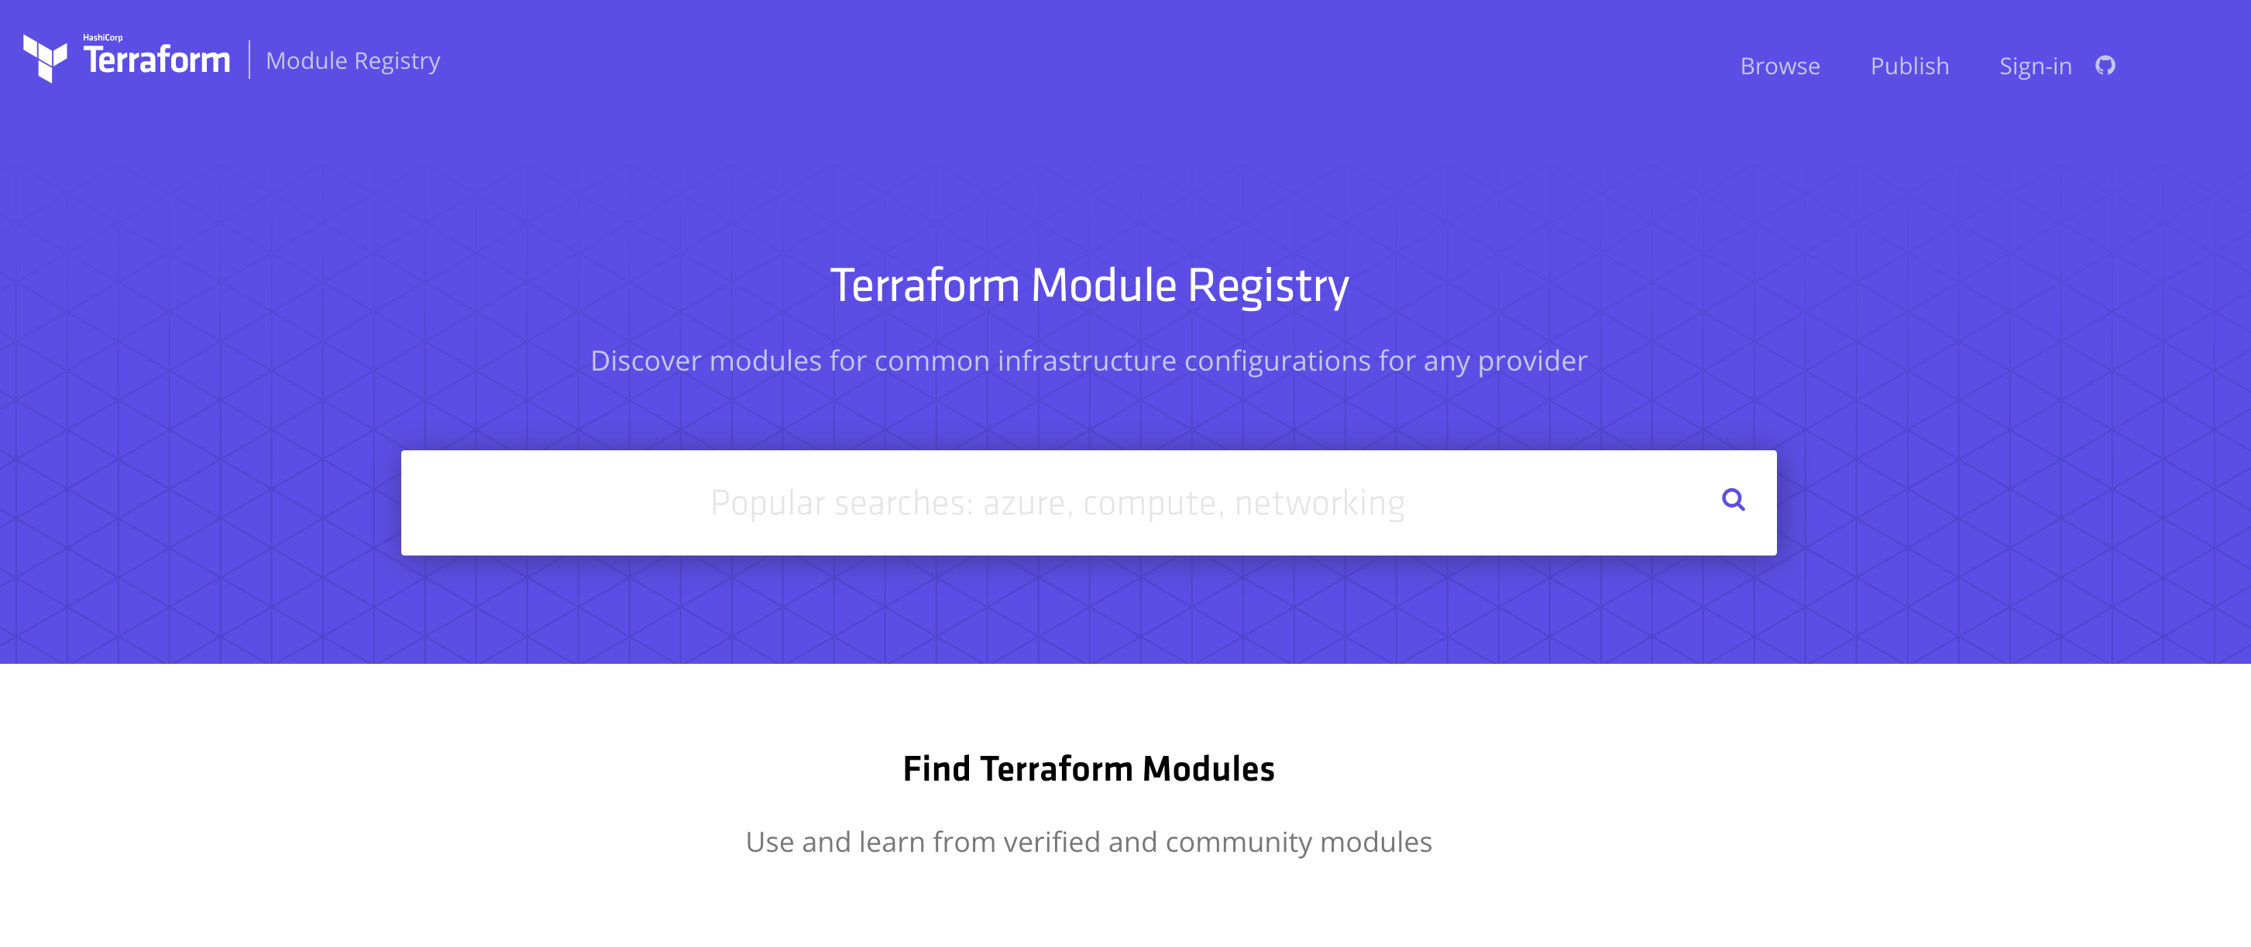
Public Module Registry
https://registry.terraform.io

Slide 116
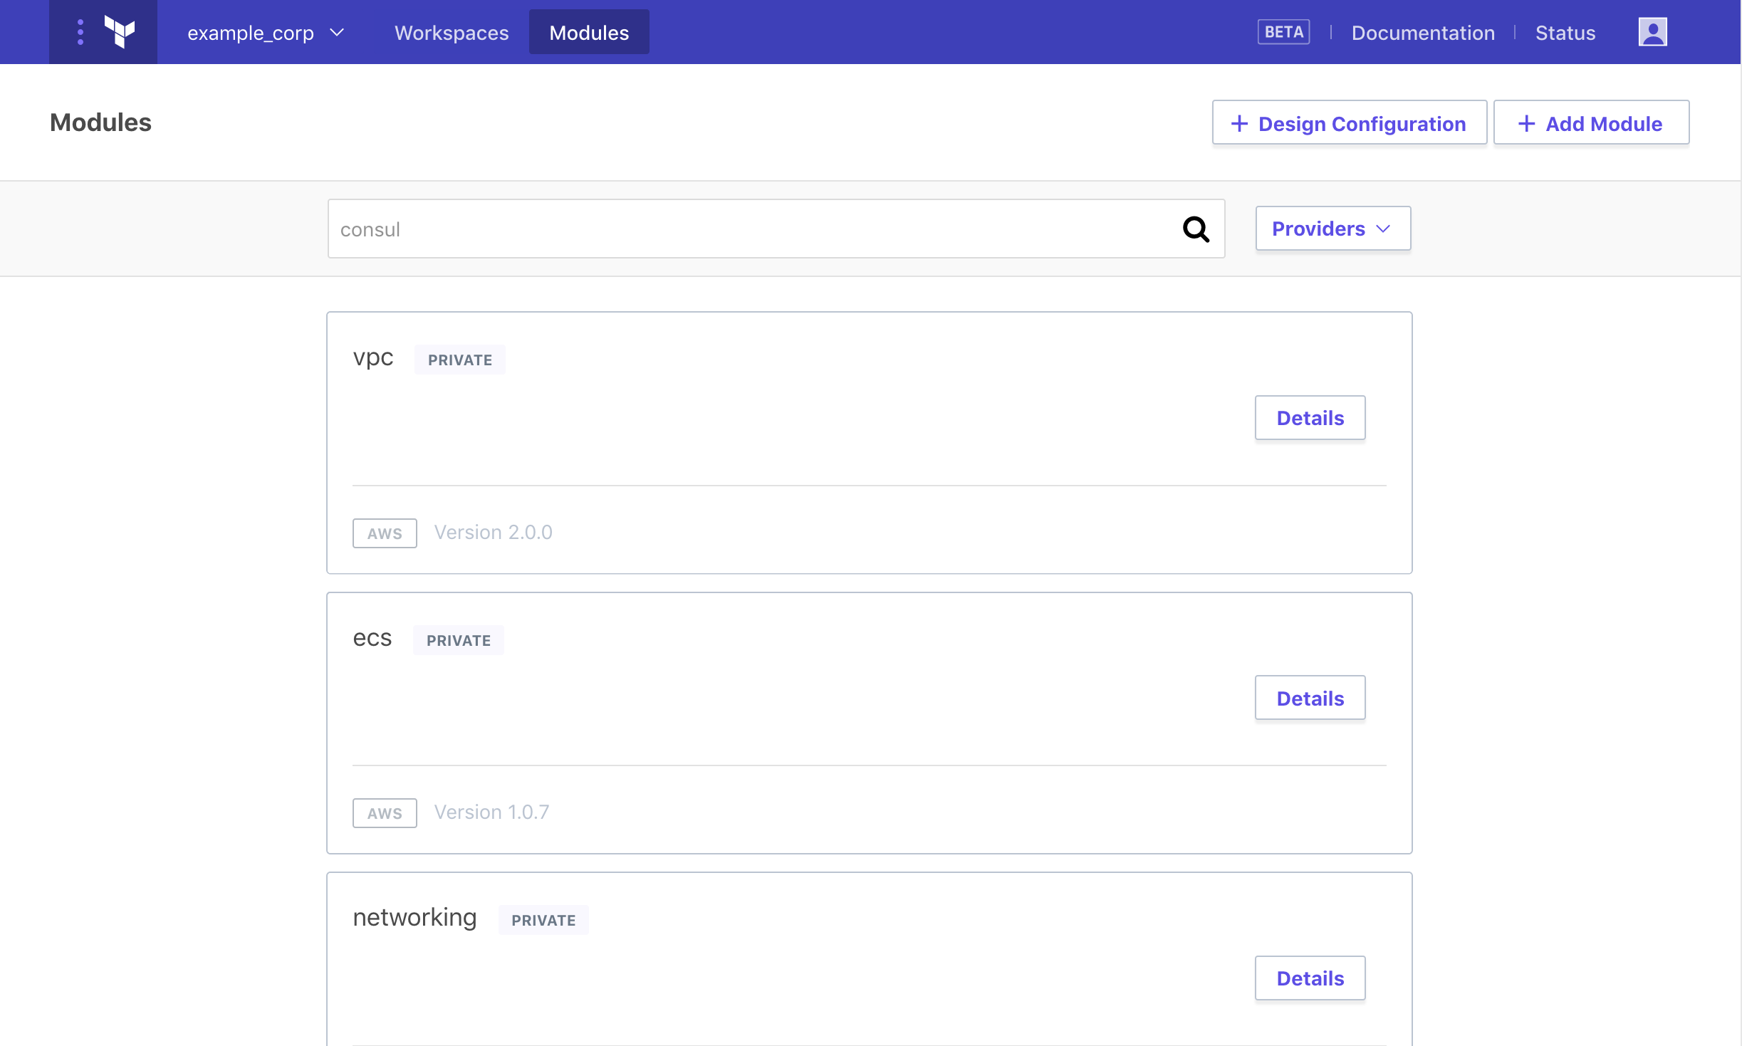
Private Module Registry
https://www.terraform.io/docs/enterprise/registry
Notes:
Terraform Enterprise

Slide 117
Backend

Slide 118
Backend
A "backend" in determines how state is loaded and how an operation such as apply is executed.
Enables non-local file state storage, remote execution, etc.
By default, Terraform uses the "local" backend.
terraform {
backend "azurerm" {
storage_account_name = "myorgeastus8x76ghf"
container_name = "terraformstate"
key = "dev.terraform.tfstate"
}
}
https://www.terraform.io/docs/backends/types/index.html

Slide 119
Backend- azurerm
terraform {
backend "azurerm" {
storage_account_name = "myorgeastus8x76ghf"
container_name = "terraformstate"
key = "dev.terraform.tfstate"
}
}
https://www.terraform.io/docs/backends/types/index.html

Slide 120
Backend
State Locking – Allows for teams to work together.
Backend Types:
azure SA
artifactory
consul
Terraform Enterprise Manages this for you!!
https://www.terraform.io/docs/backends/types/index.html
Notes:
Consul value max = 512KB.

Slide 121
Terraform Internals

Slide 122
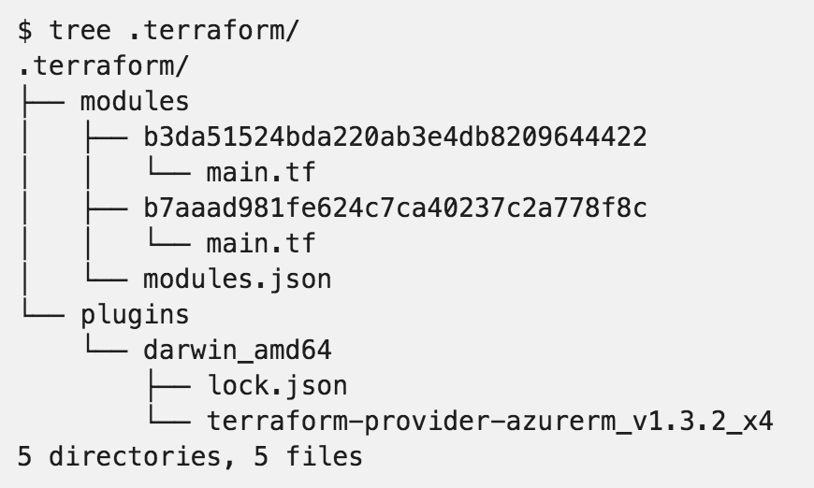
.terraform

Slide 123
Resource Addressing
Resource Address:
<MODULE PATH><RESOURCE SPEC>
azurerm_resource_group.module
module.A.azurerm_network_interface.web
https://www.terraform.io/docs/internals/resource-addressing.html

Slide 124
Resource Addressing
Module Path:
Addresses a module within a tree of modules.
module.A…
Can be multiple levels deep
module.A.module.B…
https://www.terraform.io/docs/internals/resource-addressing.html

Slide 125
Resource Addressing
Resource Spec:
resource_type.resource_name[N]
resource_type - Type of the resource being addressed.
resource_name - User-defined name of the resource.
[N] - where N is a 0-based index into a resource with multiple instances specified by the count meta-parameter.
https://www.terraform.io/docs/internals/resource-addressing.html

Slide 126
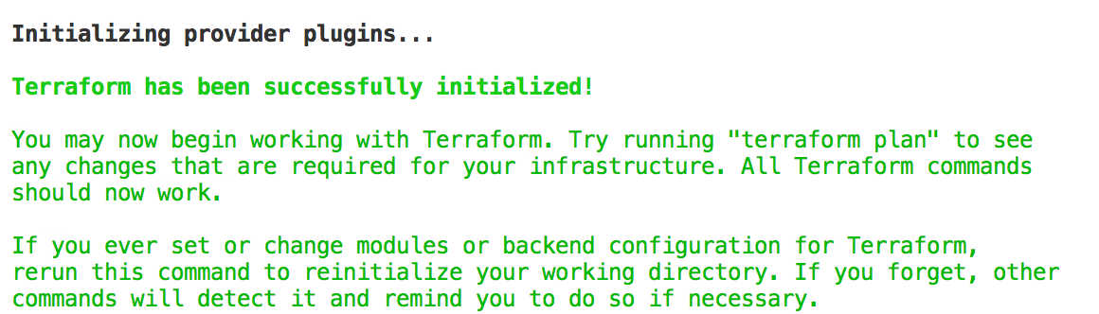
Commands - init
Usage: terraform init [options] [DIR]
https://www.terraform.io/docs/commands/init.html
Notes:
Can specify a DIR, but not recommended.

Slide 127
Commands - plan
Usage: terraform plan [options] [DIR-OR-PLAN]
Options:
-destroy If set, a plan will be generated to destroy all resources managed by the given configuration and state.
-parallelism=n Limit the number of concurrent operations. Defaults to 10.
-target=resource Resource to target.
https://www.terraform.io/docs/commands/plan.html

Slide 128
Commands - plan
Options:
-out=path Write a plan file to the given path.
-var 'foo=bar' Set a variable in the Terraform configuration. This flag can be set multiple times.
-var-file=foo Set variables in the Terraform configuration from a file.
https://www.terraform.io/docs/commands/plan.html

Slide 129
Commands - apply
Usage: terraform apply [options] [DIR-OR-PLAN]
https://www.terraform.io/docs/commands/apply.html

Slide 130
Commands - destroy
Usage: terraform destroy [options] [DIR]
https://www.terraform.io/docs/commands/destroy.html

Slide 131
Commands - fmt
Rewrites all Terraform configuration files in the current working directory.
Usage: terraform fmt [options] [DIR]
Options:
-check=false Check if the input is formatted. Exit status will be 0 if all input is properly formatted and non-zero otherwise.
https://www.terraform.io/docs/commands/fmt.html
Notes:
-check, great for CI server checks.

Slide 132
Commands - validate
Usage: terraform validate [options] [dir]
Validate the terraform files in a directory. Validation includes a basic check of syntax as well as checking that all variables declared in the configuration are specified.
https://www.terraform.io/docs/commands/validate.html

Slide 133
Commands - refresh
Usage: terraform refresh [options] [dir]
Update the state file of your infrastructure with metadata that matches the physical resources they are tracking.
This will not modify your infrastructure, but it can modify your state file to update metadata. This metadata might cause new changes to occur when you generate a plan or call apply next.
https://www.terraform.io/docs/commands/refresh.html

Slide 134
Commands - output
Usage: terraform output [options] [NAME]
Options:
-module=name If specified, returns the outputs for a specific module
-json If specified, machine readable output will be printed in JSON format
https://www.terraform.io/docs/commands/output.html

Slide 135
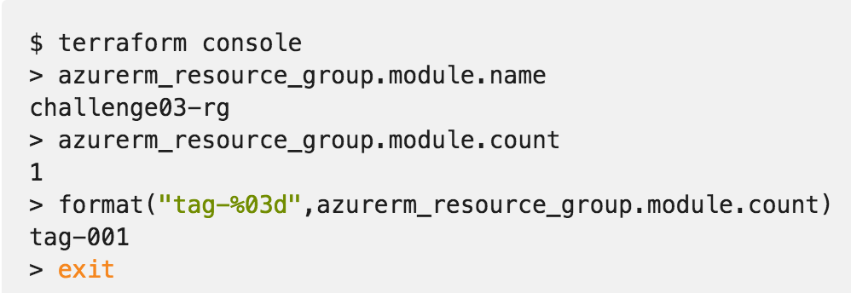
Commands - console
Creates an interactive console for interacting with Terraform.
Useful for experimenting with interpolations
and interacting with Terraform state.
https://www.terraform.io/docs/commands/console.html
Notes:
Doesn’t modify state
Can read remotes
Can work with out a state (just nothing to query)

Slide 136
Commands - graph
Usage: terraform graph [options] [DIR]
Outputs the visual execution graph of Terraform resources according to configuration files in DIR (or the current directory if omitted).
The graph is outputted in DOT format.
https://www.terraform.io/docs/commands/graph.html

Slide 137
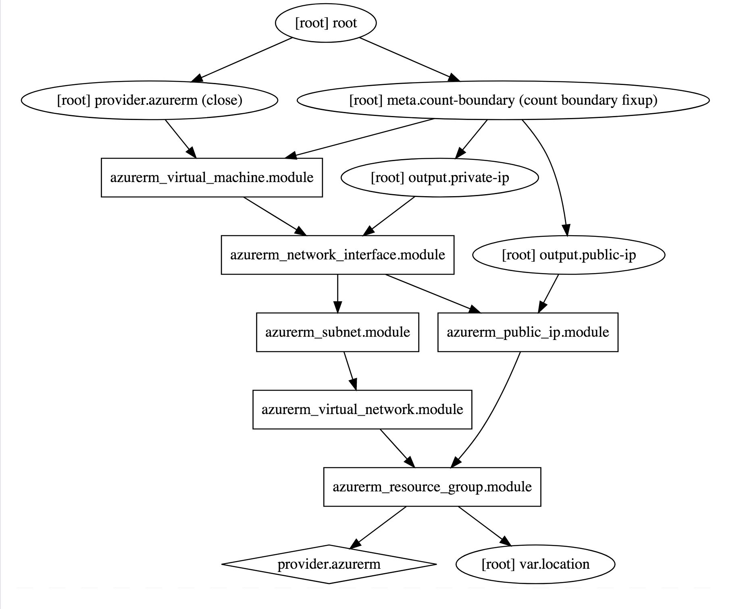
Commands - graph
terraform graph |
dot -Tsvg > graph.svg
https://www.terraform.io/docs/commands/graph.html

Slide 138
Advanced Commands
- state (list, mv, pull, push, rm, show)
- import
- taint/untaint

Slide 139
Challenge
06 – Public Module Registry
Notes:
Standup a Virtual Machine using the MS verified module.

Slide 140
Challenge
03 - Provision Azure Virtual Machines
04 - Scaling Infrastructure with Count
Notes:
Create a Virtual Machine step by step.
Scale the Virtual Machine.

Slide 141
Challenge
05 – Using Modules
06 – Public Module Registry
Notes:
Using modules

Slide 142
Terraform Enterprise

Slide 143
Terraform Open Source and Terraform Enterprise
OSS for technical complexity & Enterprise for organizational complexity
Governance
Organizational Complexity
Gold Support
Collaboration
Collaboration
Silver Support
Provisioning
Provisioning
Provisioning
Individuals use
OSS
Teams use
Pro
Organizations use
Premium
Notes:
Open Source:
IaC
Workflow (plan/apply)
Public Module Registry
Enterprise Pro:
Workspace Management GUI
VC Connections
Private Module Registry
SaaS
Enterprise Premium:
Private Install option
Policy as Code
Audit Logs

Slide 144
Terraform Open Source and Terraform Enterprise
OSS for technical complexity & Enterprise for organizational complexity
Governance
Organizational Complexity
Gold Support
Collaboration
Collaboration
Silver Support
Provisioning
Provisioning
Provisioning
Individuals use
OSS
Teams use
Pro
Organizations use
Premium
Notes:
The foundation of Terraform is the open source project and addresses the concern for individuals:
use infrastructure as code to create reusable configuration, enable automation, and manage infrastructure in cloud, at scale
use a consistent workflow for many different infrastructure providers to safely and consistently provision infrastructure and without having to learn other provision and management tools
As Terraform adoption grows beyond 1 or 2 users (which is how it generally begins) and as the organizational structure of infrastructure management grows there are a set of requirements around collaboration and governance that become helpful to using Terraform at scale for your organization.
Additionally to this, there is also the element of support for daily and long term success through enterprise levels of support. This includes both on-call support for daily issues but also long-terms architecture guidance and technical account management. This is what is offered as part of Terraform Enterprise. The focus of the Terraform Enterprise Pro is collaboration and the Terraform Enterprise Premium is governance.

Slide 145
Terraform OSS workflow for individuals
DEVELOPER
OPERATOR
VCS
Notes:
For collaboration, lets take a quick look back at the OSS workflow.
In this scenario there is 1 or 2 individuals using Terraform configurations to create and update the infrastructure.
And this is relatively simple to coordinate these changes.
However as more operators become proficient using Terraform and are brought on to help provision large scale infrastructures tis models expands.

Slide 146
How can teams safely collaborate on infrastructure
DEVELOPERS
OPERATORS
VCS
Notes:
Now there are multiple operators creating Terraform configurations, and in the case of more complex infrastructure one operator might be responsible for the networking infrastructure, and one operator responsible for the core infrastructure, and one operator responsible for web properties, etc.
Additionally, to this more operators are starting to consume the infrastructure provisioned by Terraform for their various different applications. The coordination of all of these runs is not trivial, each users is running their private installation of Terraform and updating the same infrastructure.

Slide 147
Workspaces

Slide 148
Workspace management and VCS connection
INFRASTRUCTURE AS CODE
DEVELOPERS
OPERATORS
Core
Provider
VCS
Notes:
To address this Terraform Enterprise provides Terraform Workspace management and UI with remote state storage, plans, and applies to remove the challenge of coordination.
Terraform Enterprise Workspaces has an API by design approach making it easy for you to integrate into your environment and existing tooling.
Workspaces are connected to Version control system repositories
Workspaces can be created in a granular way to align with how the infrastructure is organized. For example, workspaces can be organized by the stage of application delivery (development/test/production) and/or the type of infrastructure (networking/compute/monitoring/web).
Developer can use a private version of a module registry in the Terraform Enterprise UI to search for pre-defined modules to spin up infrastructure to run their applications.

Slide 149
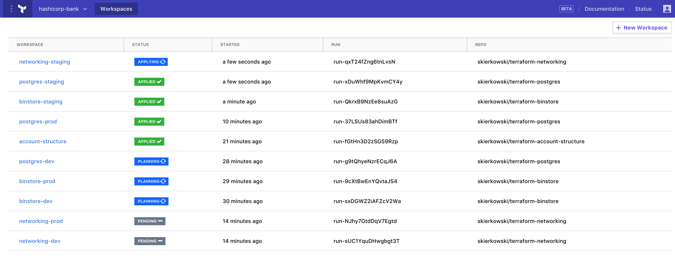
Workspace management and VCS connection
INFRASTRUCTURE AS CODE
TEAMS OF DEVELOPERS
TFE Workspace Management
TEAM OF OPERATORS
Core
Provider
VCS
Terraform Configuration
Notes:
Here is a view of Terraform Enterprise Workspace management with Workspace a the standard for how infrastructure is organized.
Run simil

Slide 150
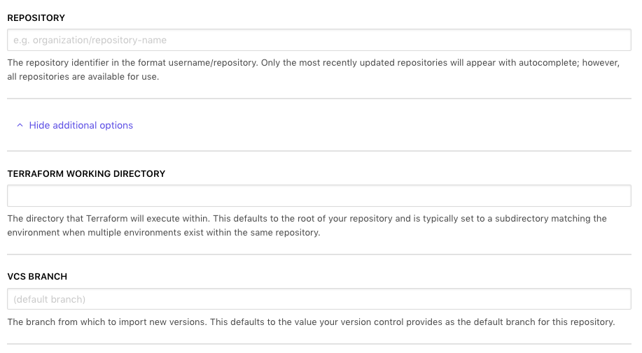
Workspace – VC Connection
https://www.terraform.io/docs/enterprise/vcs
Notes:
Version Control Connection – github, gitlab, bitbucket
Options:
- working directory
- branch

Slide 151
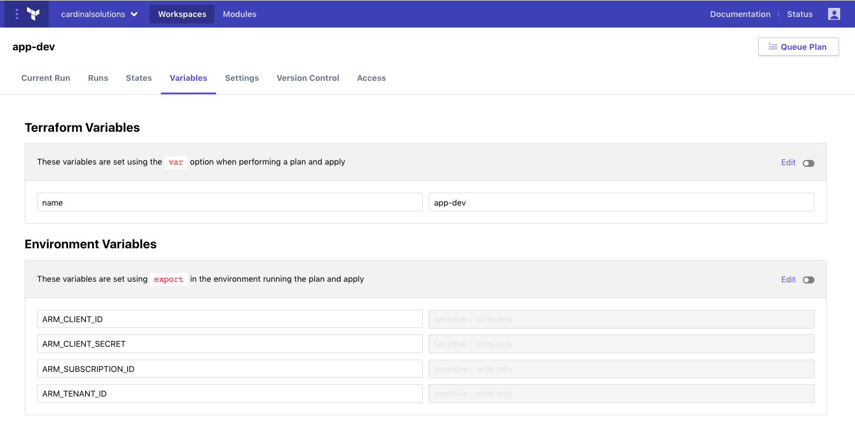
Workspace – Variables
https://www.terraform.io/docs/enterprise/workspaces/variables.html

Slide 152
Workspace – Variables
https://www.terraform.io/docs/enterprise/workspaces/variables.html
Notes:
HCL Type Variable
Sensitive
Nobody (including you) can view the value in TFE's UI or API. COULD BE IN LOGS
Nobody can edit the variable's name or value
Also works on ENV Vars

Slide 153
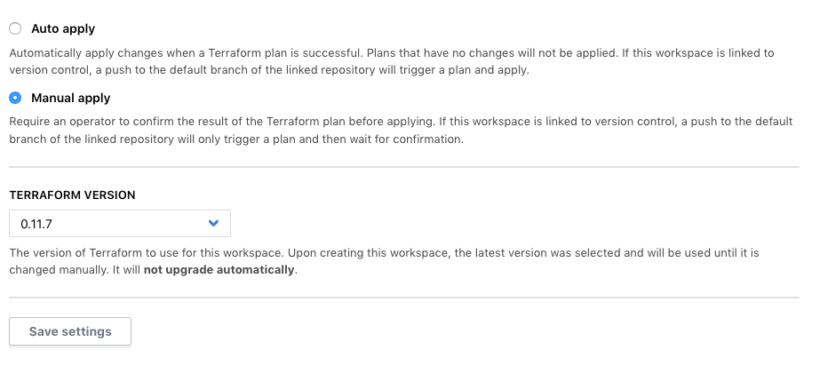
Workspace – Settings
https://www.terraform.io/docs/enterprise/workspaces/variables.html

Slide 154
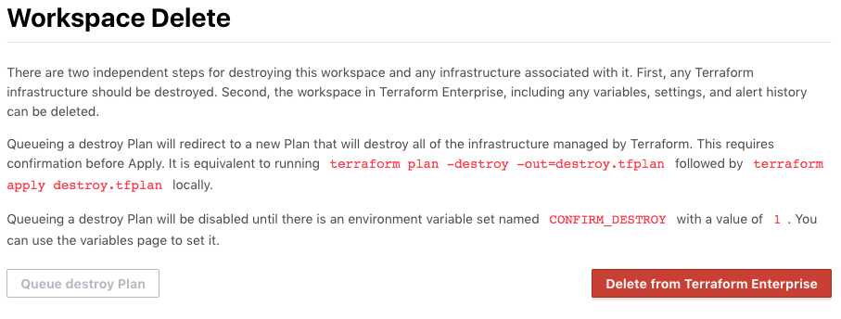
Workspace – Settings
https://www.terraform.io/docs/enterprise/workspaces/variables.html
Notes:
Deleting Works space infra
Update ENV Var
Click Destroy Plan

Slide 155
Remote State

Slide 156
Remote Terraform runs and state management
INFRASTRUCTURE AS CODE
PROVISIONING WORKFLOW
DEVELOPERS
Plan
OPERATORS
Core
Provider
Apply
Notes:
Terraform runs including the plan and apply can be done remotely.
Terraform Enterprise provides enhanced remote state storage
Runs triggered from the CLI also show up in the UI. Users can continue using the same OSS workflow (if that is what they are comfortable with) and it registers with TFE.

Slide 157
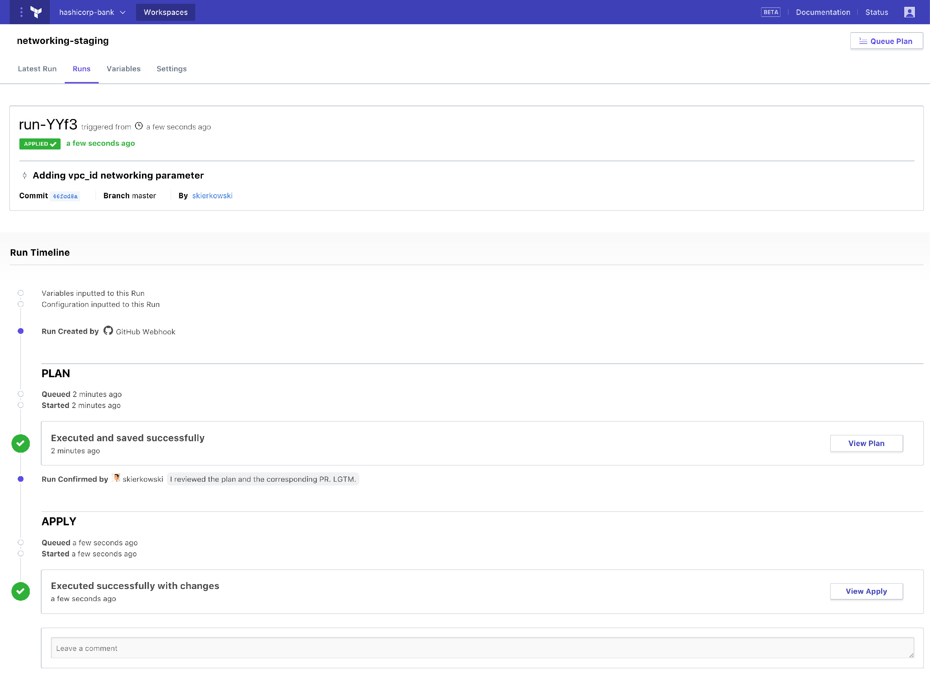
Remote state management and Terraform runs
INFRASTRUCTURE AS CODE
TEAMS OF DEVELOPERS
TFE Workspace Management
TEAM OF OPERATORS
Core
Provider
VCS
Terraform Configuration
Notes:
Here is a view of a Terraform run from Terraform Enterprise.
Terraform Infrastructure as code and Terraform Enterprise Workspace management and collaboration enables operators to automate provisioning at scale. However, this comes with risks, as every action can have larger effect.

Slide 158
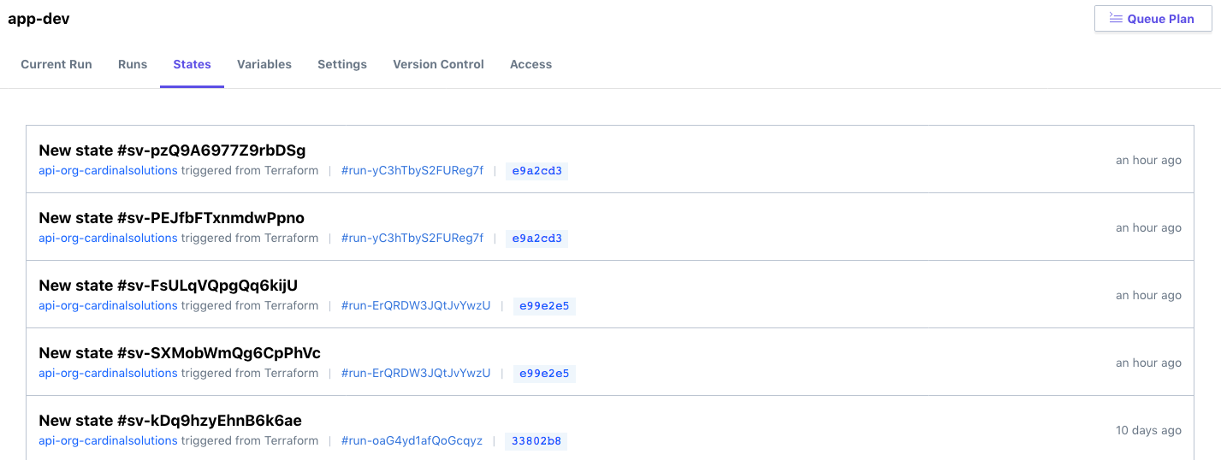
Workspace – State Management

Slide 159
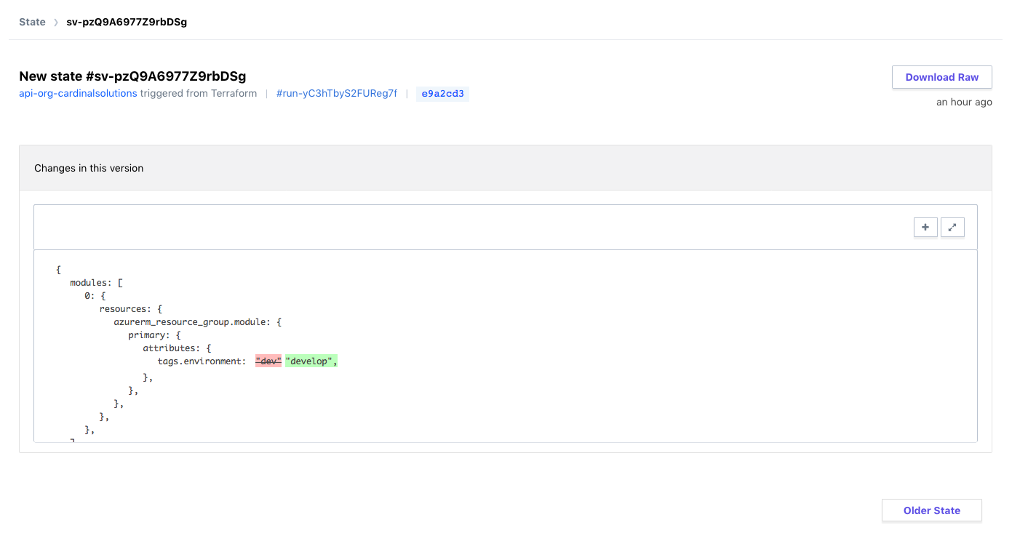
Workspace – State Management

Slide 160
Challenge
08 - Terraform Enterprise Setup

Slide 161
Collaboration

Slide 162
Collaboration
Role Based Access Controls
Permissions
Read
Write
Admin
Notes:
Devs can apply to dev environment, but not to Prod
Typical RBAC methodology

Slide 163
Collaboration
Role Based Access Controls
Organization
Teams
Users
Notes:
Devs can apply to dev environment, but not to Prod
Typical RBAC methodology

Slide 164
Service Accounts
API Tokens
User
Team
Organization
Notes:
Just as a user/team/org can be scoped, so can the API Tokens
Inherit the same permissions

Slide 165
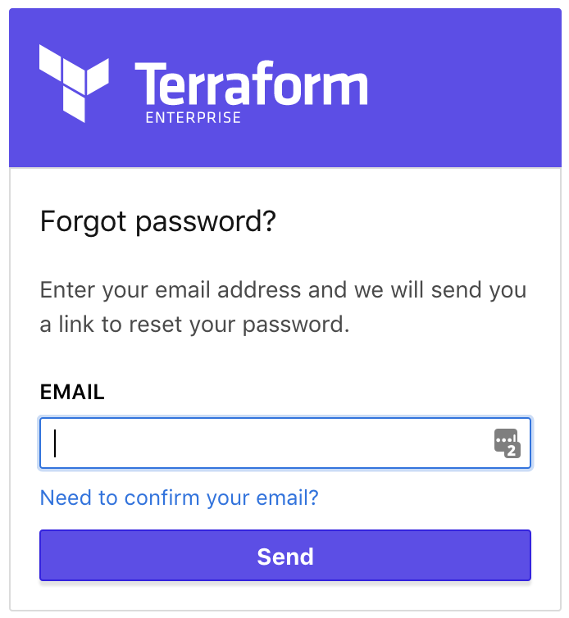
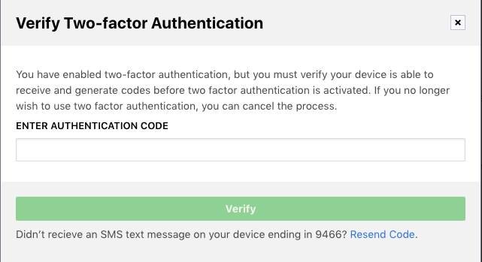
User Authentication
Notes:
Self Service Password Reset
2FA

Slide 166
Demo
Notes:
Create feature branch against workspace app-dev to update a tag.
Submit PR – see TFE running plans
These plans are temp and not linkable from TFE directly, use github.
Accept PR and see official plan.
Review and apply.

Slide 167
Private Module Registry

Slide 168
Private Module Registry
Modules for sharing across organization
Versioning
Notes:
Used in the same way as the Public Module Registry.
Allows sharing/collaboration

Slide 169
Private Module Registry
Show Module discovery in private repo
Documentation of modules
Notes:
Used in the same way as the Public Module Registry.
Allows sharing/collaboration

Slide 170
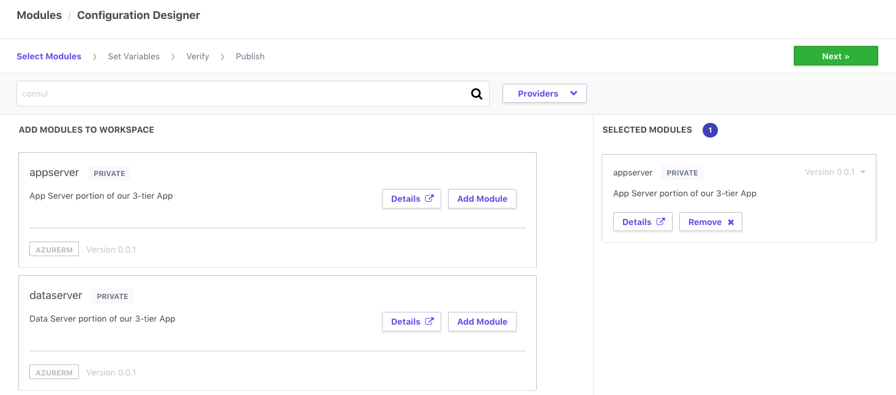
Design Configuration

Slide 171
Demo
Notes:
Create a new module design configuration.
Use an existing module and populate values.

Slide 172
Challenge
09 - Private Module Registry

Slide 173
Governance

Slide 174

Enable Organization to have governance over infrastructure
Ensure provisioning policy is being maintained to minimize risk to the business
INFRASTRUCTURE AS CODE
PROVISIONING WORKFLOW
Extensible provider model
DEVELOPERS
Plan
GCP
√
OPERATORS
Core
Provider
√
AWS
√
Azure
√
Apply
Notes:
Then the execution phase happens and the resources are provisioned across the various providers detailed in the configuration file.
However, the as more resource are provisioned by more users the challenges is in making sure infrastructure changes are doing so within business and/or regulatory policy. Such policies might be:
Not allow resources to be provisioned without tags
Not allow “development” resources to be provisioned in “us-east-1”
Restrict AWS security group ingress and egress settings by CIDR block
Not allow resources to be provisioned outside of business hours
Manually trying to enforce these constraints will be difficult once usage scales beyond a few people provisioning infrastructure.
And to address this is policy as code to automate policy checks.

Slide 175
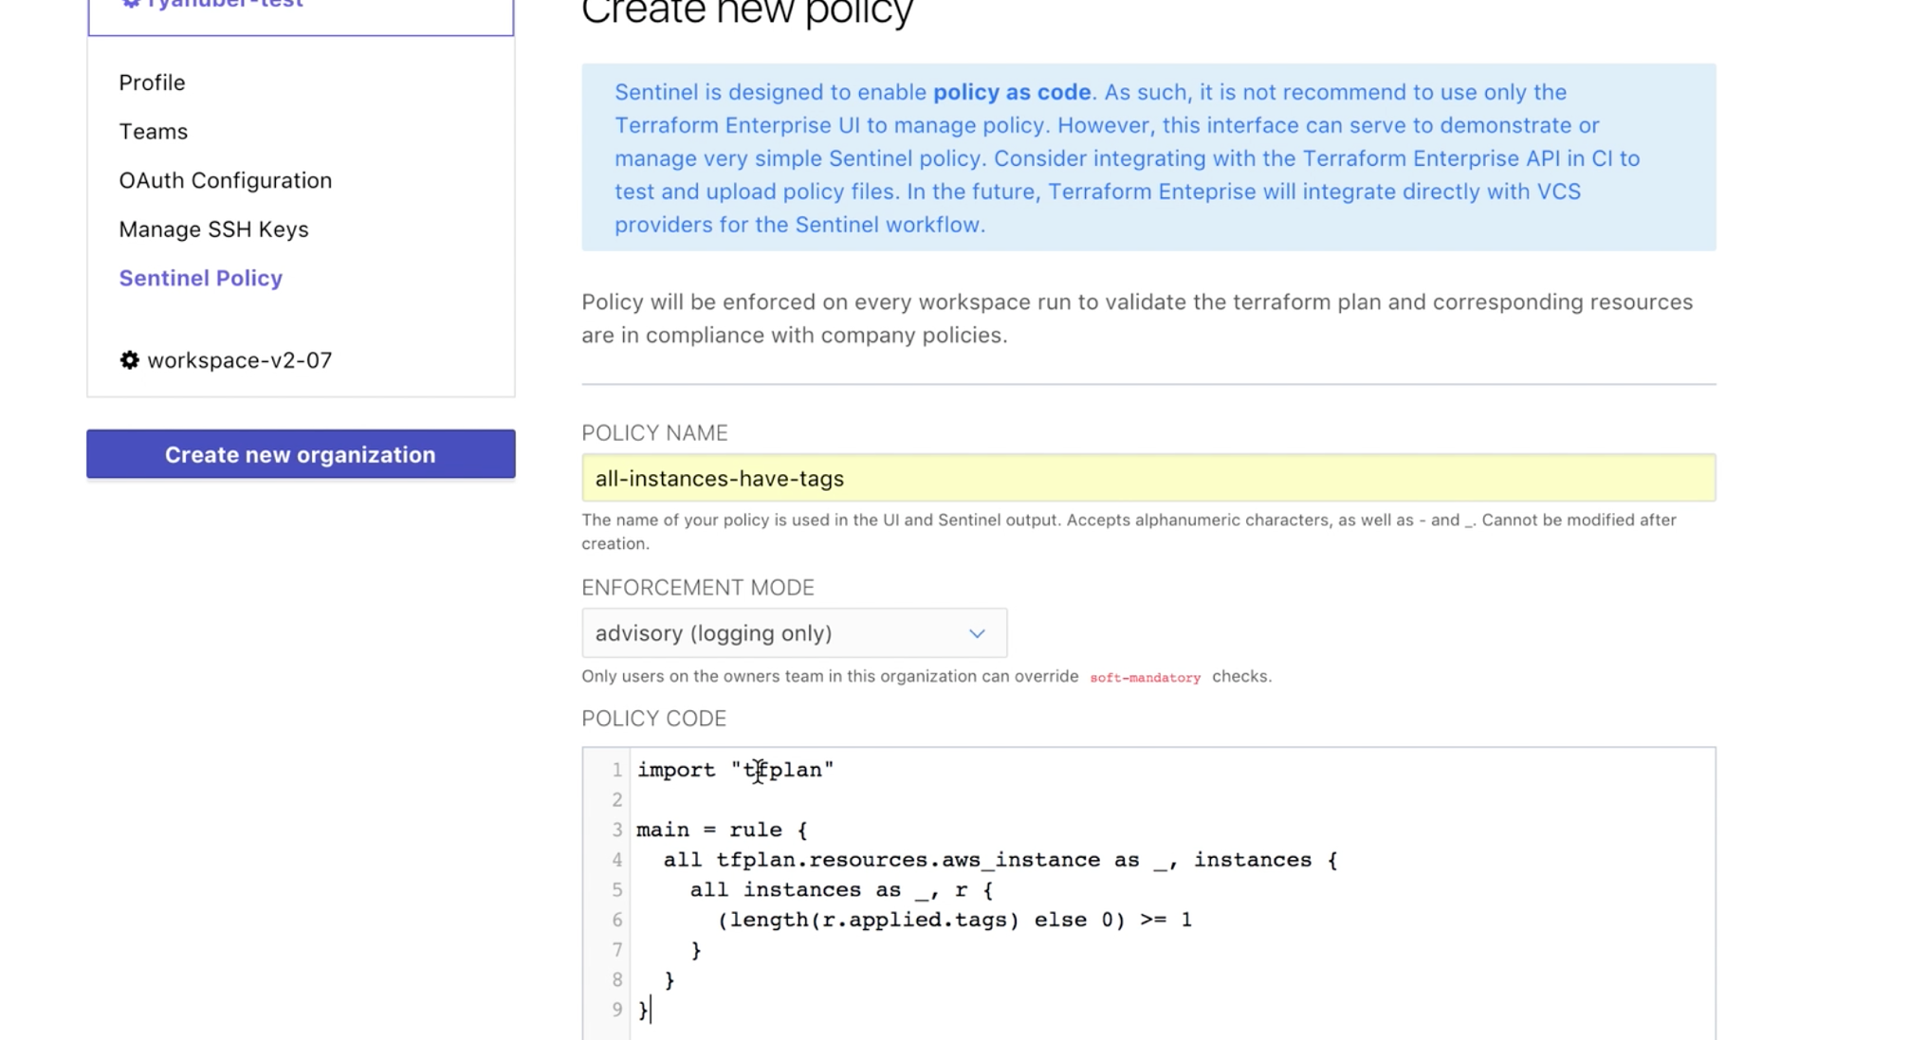
Enable Organization to have governance over infrastructure
Automate policy with Sentinel policy as code management
INFRASTRUCTURE AS CODE
DEVELOPERS
OPERATORS
Core
Provider
VCS
+ policy
Notes:
HashiCorp Sentinel is a policy as code framework and allows these types of constraints to be codified and automated with in Terraform Enterprise.
Sentinel policies are configured on an organization within Terraform Enterprise and are applied to all runs on all workspaces within that organization.
Policy code is entered into Terraform Enterprise using the API or the web UI, and full VCS integration for policy as code will be coming soon.

Slide 176

Enable Organization to have governance over infrastructure
Ensure provisioning policy is being maintained to minimize risk to the business
DEVELOPERS
Plan
OPERATORS
Core
Provider
Apply
Notes:
Example policy for infrastructure provisioning:
Do not allow resources to be provisioned without tags
Only allow staging resources in us-west-1 and production resources in us-east-1
Do not allow AWS security groups to have egress set to 0.0.0.0

Slide 177
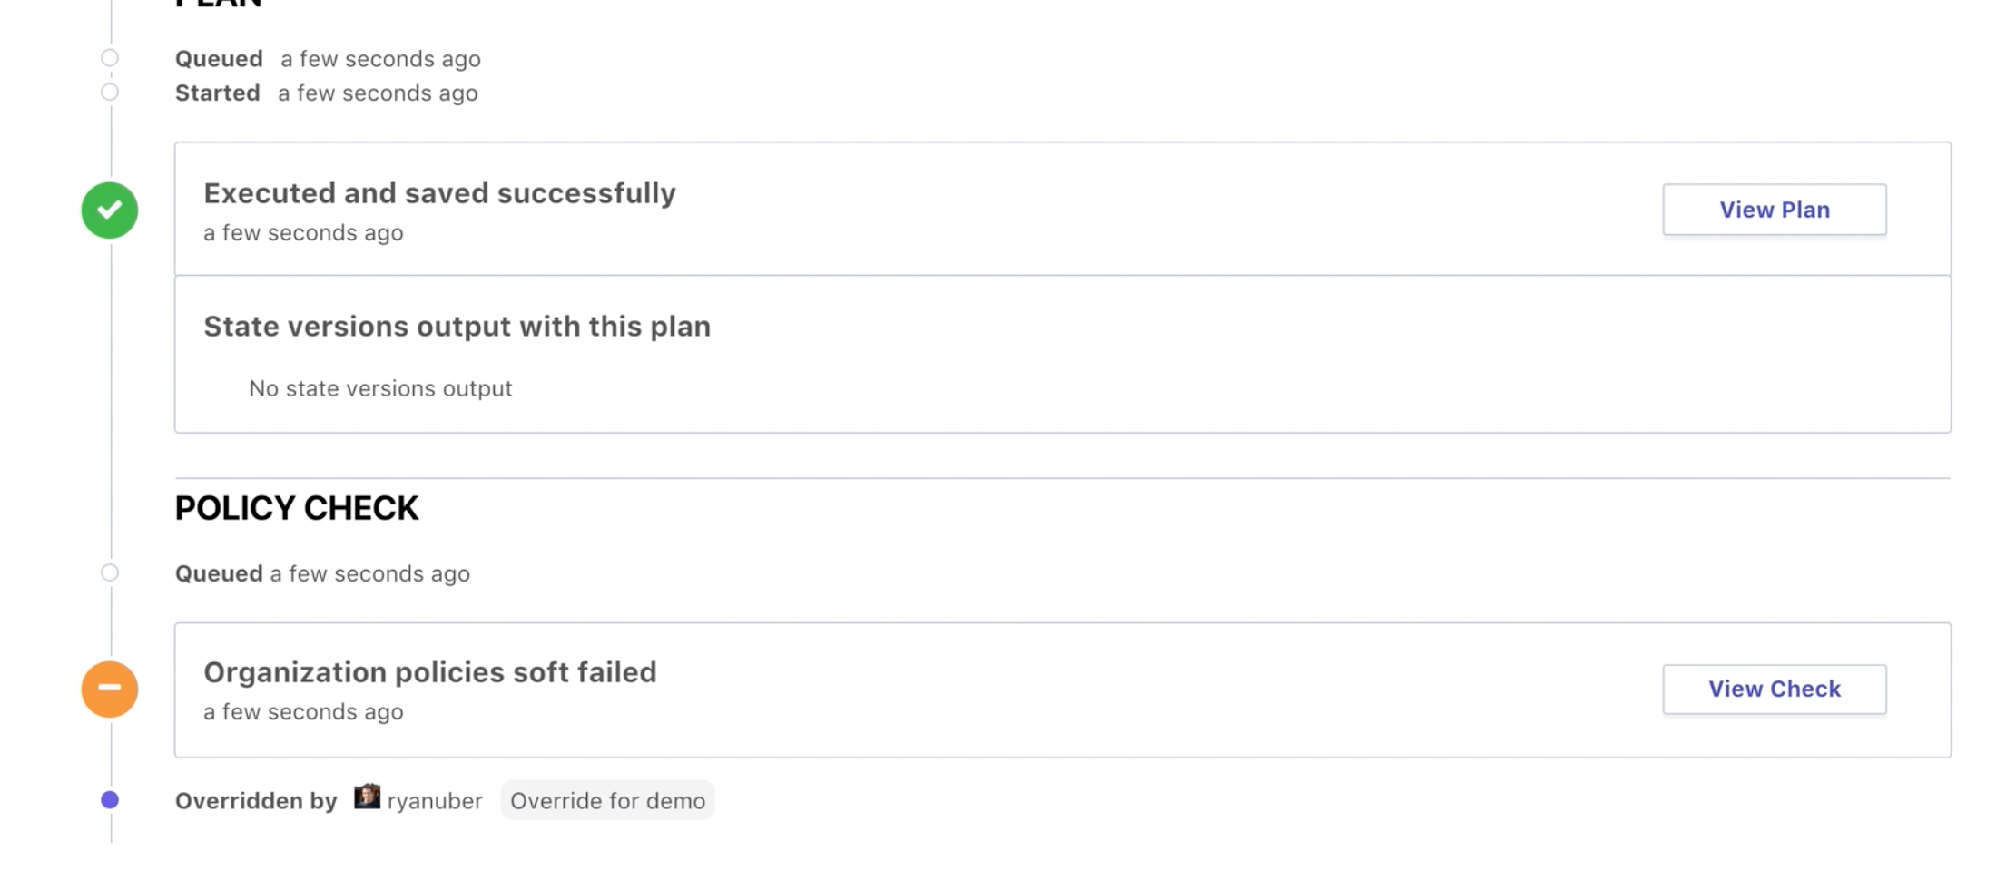
Enable Organization to have governance over infrastructure
Automate policy to be enforced on every Terraform run
INFRASTRUCTURE AS CODE
PROVISIONING WORKFLOW
DEVELOPERS
Plan
OPERATORS
Core
Provider
√
Apply
Notes:
The policy check is built into the Terraform workflow after the Terraform plan.
The “tfplan” plugin is imported, and then used to access the set of Terraform resources we are interested in, for the policy to actually be checking.
Sentinel policies in Terraform Enterprise are enforced immediately after a plan completes. This is reflected on the Runs view page. The “Policy Check” section will appear when the plan completes
For policy checks, there are various enforcement levels to provide the appropriate level of constraint while still enabling productivity. There are 3 levels to choose from:
Advisory mode logs warnings, but does not prevent runs from being applied. This is useful for teaching users good habits without preventing actions.
Soft mandatory mode requires an operator with appropriate permissions to override any policy failures prior to an apply. This is useful for policies like "Users cannot provision outside of business hours", which require a failsafe.
Hard mandatory mode does not allow any override, and policies must pass prior to an apply. This is useful for policies that enforce regulatory requirements like "All database volumes must be encrypted."
The workspace owner is able to confirm and apply a run that passes policy checks freely.

Slide 178
Enable Organization to have governance over infrastructure
Ensure provisioning policy is being maintained to minimize risk to the business
DEVELOPERS
Plan
OPERATORS
Core
Provider
Apply
Notes:
Here is a view of a Terraform run from Terraform Enterprise with the policy check applied after the Terraform plan.
This particular run had a soft fail that was able to be overridden by a user with the appropriate permission.

Slide 179
Enable Organization to have governance over infrastructure
Automate policy to be enforced on every Terraform run
INFRASTRUCTURE AS CODE
PROVISIONING WORKFLOW
Extensible provider model
DEVELOPERS
Plan
GCP
√
OPERATORS
Core
Provider
√
√
AWS
Azure
√
Apply
Notes:
With Sentinel policy as code the appropriate guardrails are automatically in-place to protect users from creating infrastructure changes that fall outside of business and/or regulatory policies.

Slide 180
Challenge
10 - Sentinel Policy

Slide 181
1 Week PoC
C
Pre-Requisites
- An available Azure subscription with sufficient funding
- Desired set of infrastructure to deploy to Azure
- Availability of required SMEs (application architects,
cloud architects, DevOps manager, etc.)
What You Will Get
- Purpose built infrastructure configuration based on your organizations needs/goals utilizing the best practices established performing large scale deployments
- Terraform configuration representing a one or more application environments including neccessary networking (Vnets/Subnets/Peerings)
- Remote state configuration allowing for multiple team collaboration
- Terraform Enterprise integration and design considerations
- Presentation and documentation to prepare your teams to develop, maintain, and deploy your Terraform

